Slide 1

1976 Hutt County District Scheme Review.
Proposal to zone the Spur partly as town belt, and part (over half) as Special Residential, which would have allowed for residential development to occur at the eastern (Kiln Street) end.
A scenic lookout and an access road from Kiln Street were part of this proposal.
The balance of land in the area including the tops of the Pinehaven hills was all proposed to be zoned as town belt.

Slide 2
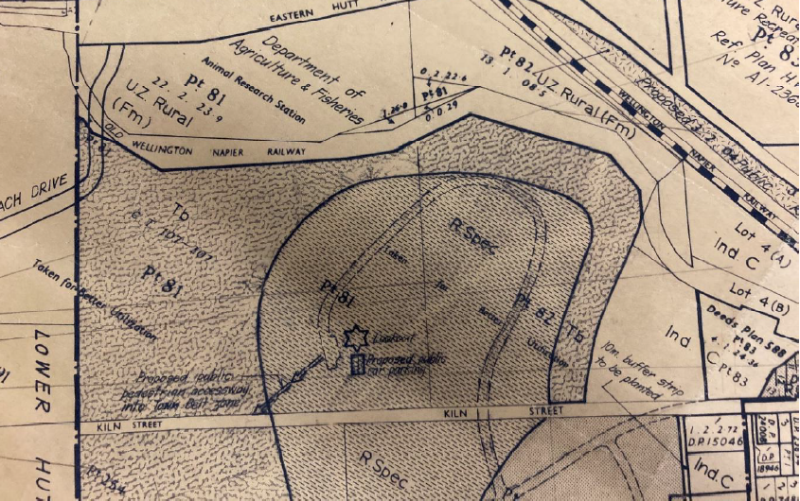

Slide 3
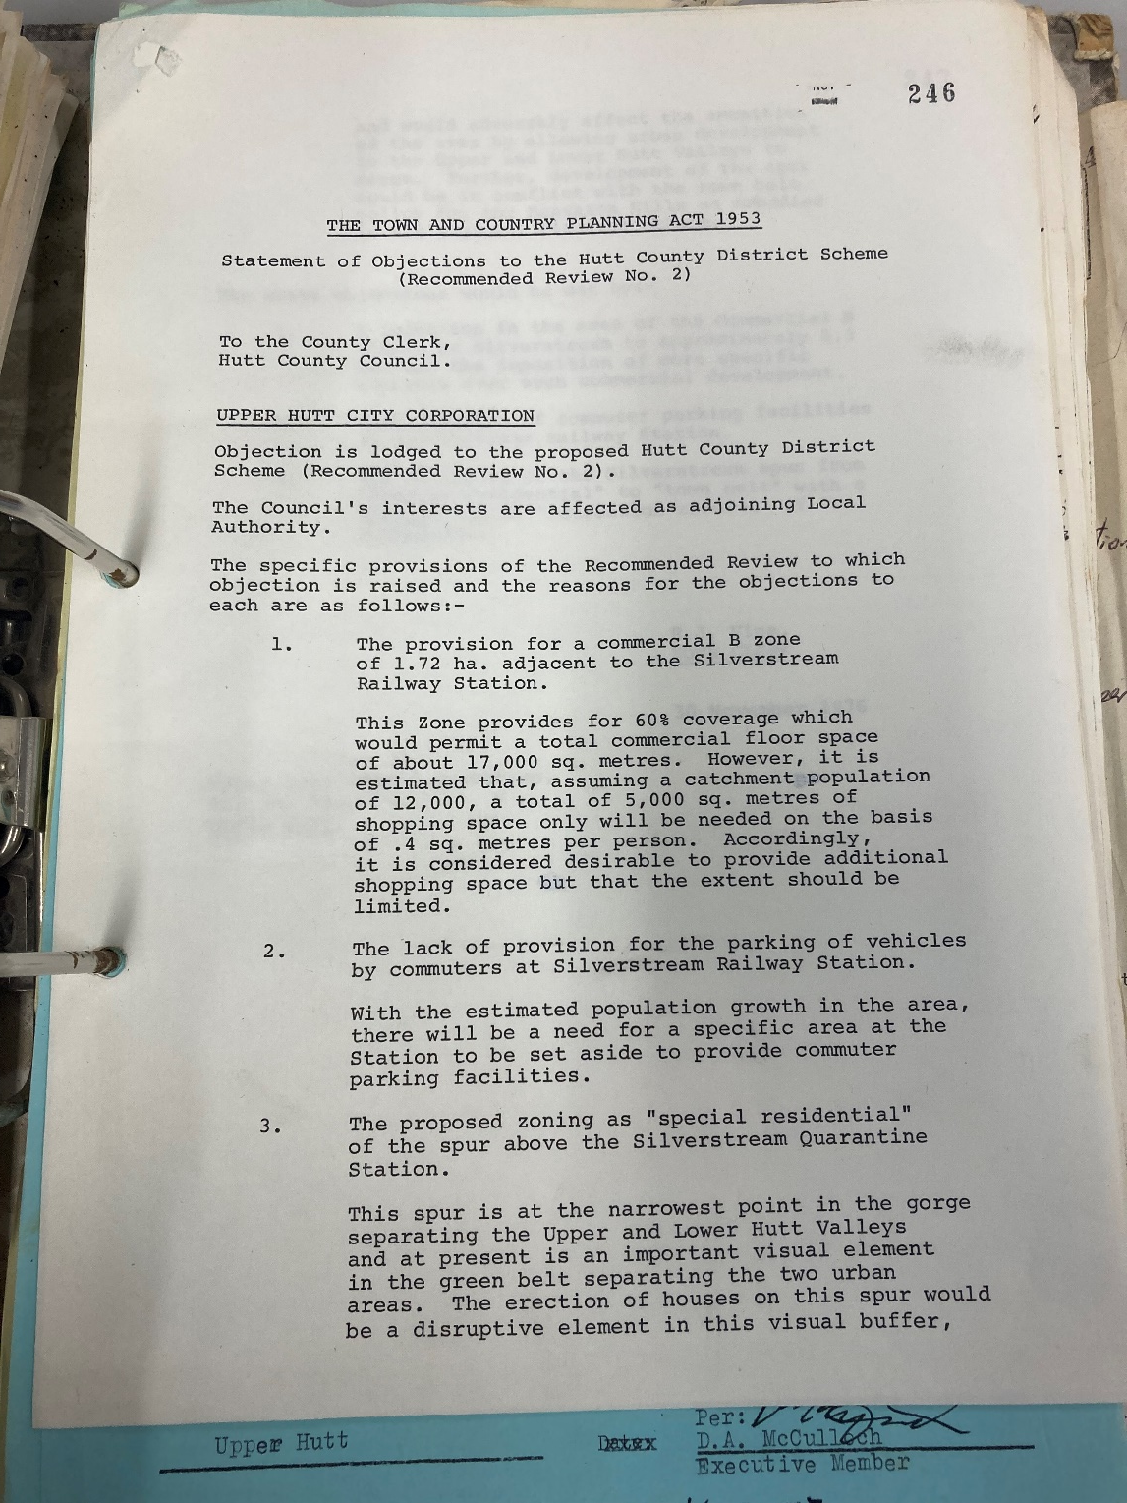
Upper Hutt City Council were one of the strongest objectors to this proposal with the submission stating:
The “spur is the narrowest point in the gorge separating the Upper and Lower Hutt Valleys and at present is an important visual element in the green belt separating the two urban areas. The erection of houses on this spur would be a disruptive element in this vital buffer”.

Slide 4
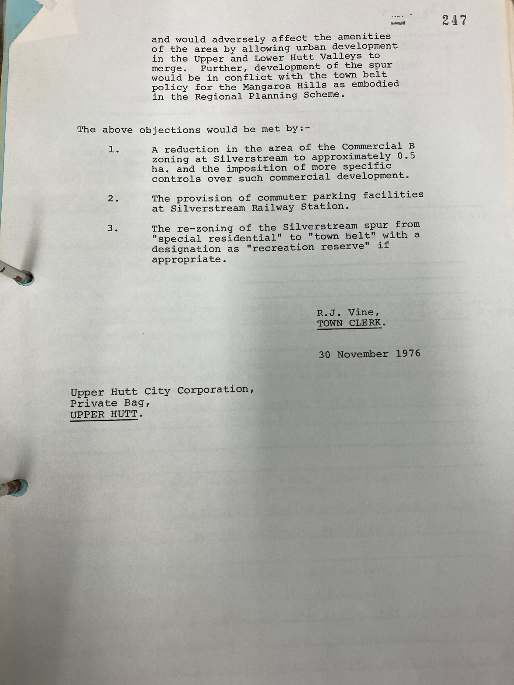
They went on to say that housing “would adversely affect the amenities of the area by allowing urban development in the Upper and Lower Valleys to merge. Further, development of the spur would be in conflict with the town belt policy for the Mangaroa hills as embodied in the Regional Planning Scheme”
UHCC wanted the Spur zoned Town Belt “with a designation as recreation reserve if appropriate”

Slide 5
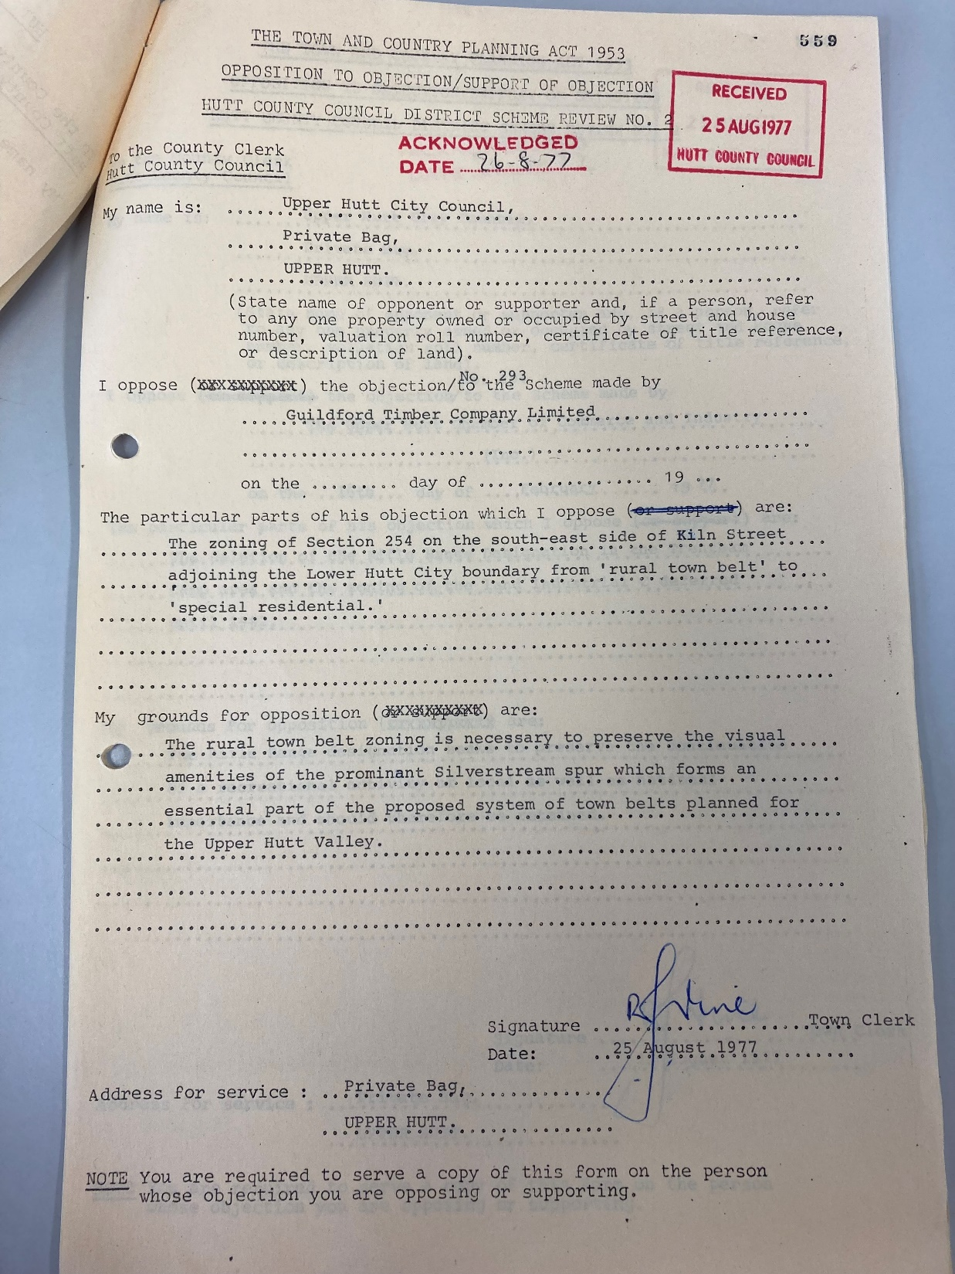
After the submissions were released in 1977, UHCC made a cross objection against the Guildford Timber Company, once more pointing out in great detail just how important of a visual amenity the Spur was and that it should be designated “Scenic Reserve” in the district scheme.

Slide 6
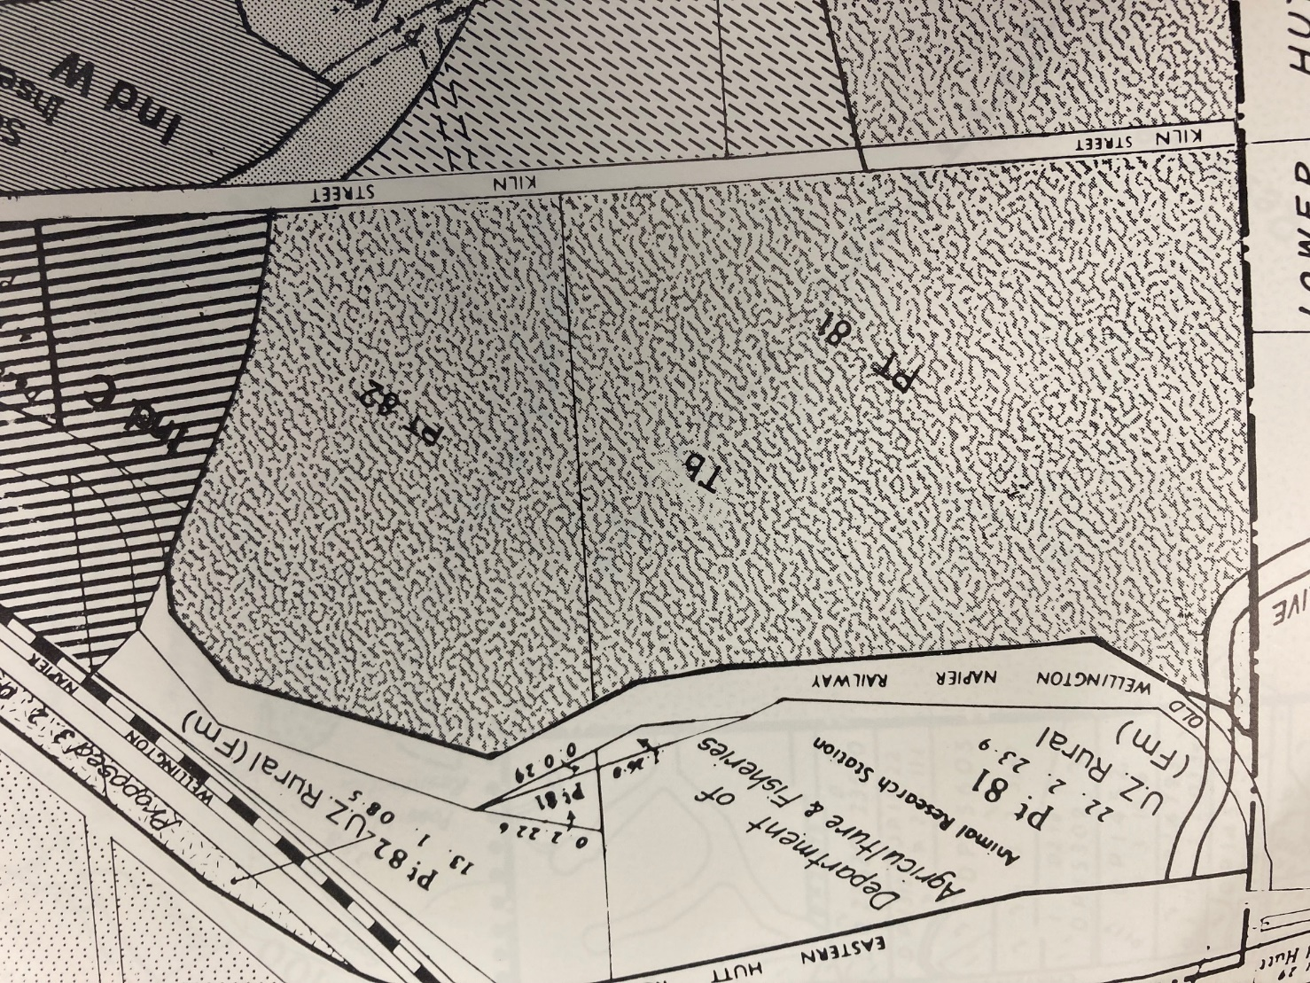
By 1984 when the approved planning maps were released and adopted the Spur had been zoned in its entirety as Town Belt.
Upper Hutt City Council succeeded in their goal to Save the Spur and keep it free from development.

Slide 7
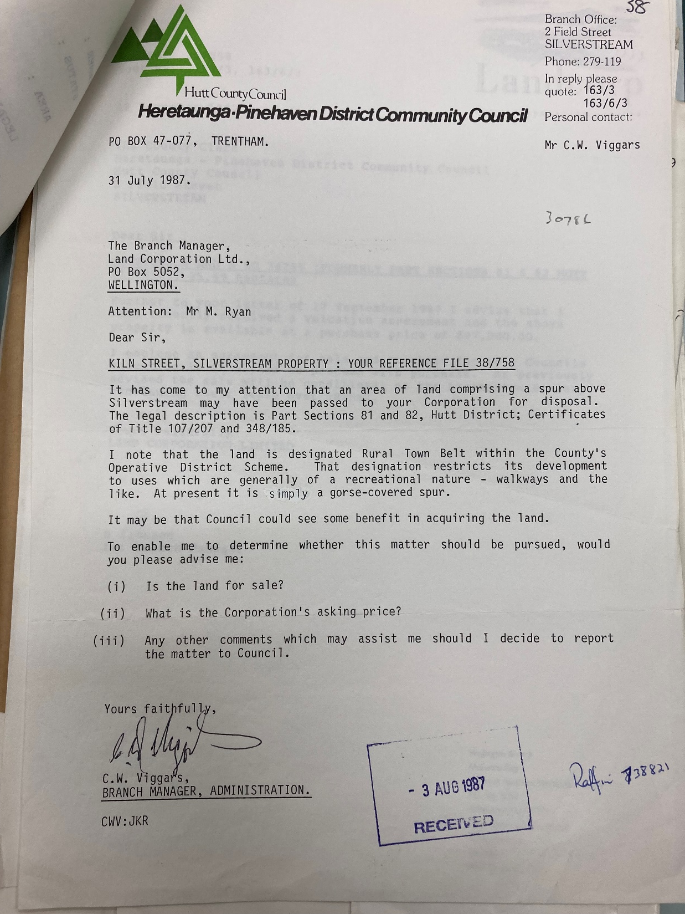
The 31st of July 1987 began the next stage of the Spur’s future, when a letter was sent from the Heretaunga Pinehaven District Community Council to Landcorp asking if the Spur was for sale and for how much.

Slide 8
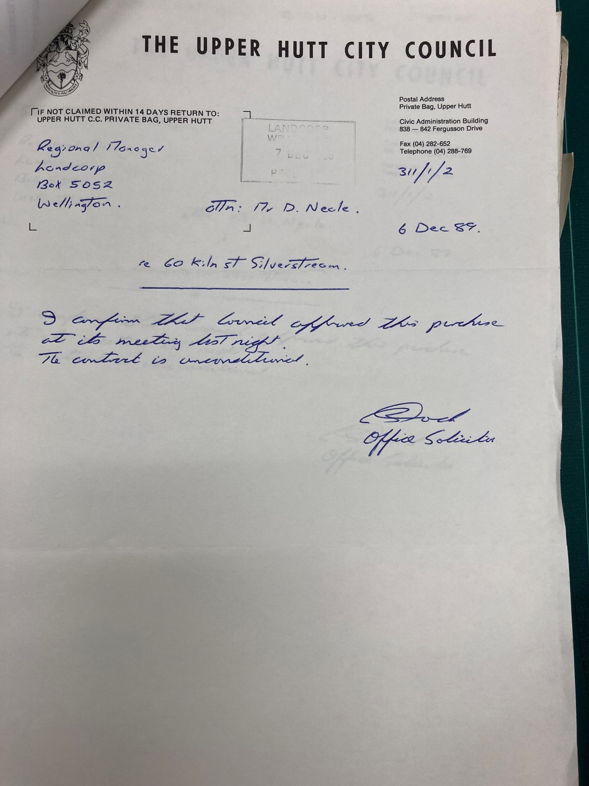
In May 1989 UHCC received a copy of the valuation commissioned by them for comparison with the one commissioned by Landcorp. The figures the Valuer’s eventually agreed upon was $59,000.
After being discussed in Council meetings during 1989 the land was approved for purchase in December 1989.

Slide 9
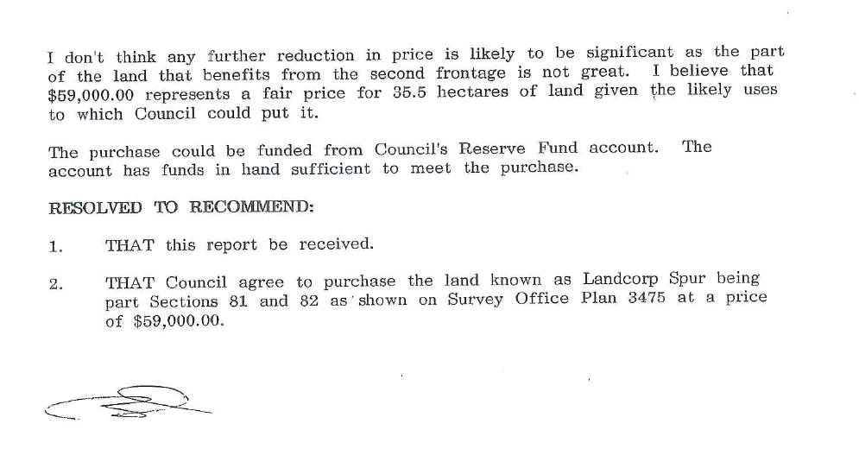
The purchase was funded from the “Reserve Fund”.

Slide 10
What is a Reserve Fund?
Not a back up fund in case other money ran out.
Council’s in NZ collected either land or money from developers that were to be used as public reserves.
If the subdivision had land that was suitable for a reserve the developer could offer that as their reserve contribution. Usually possible with larger subdivisions
Smaller subdivisions that did not have suitable land available were made to pay a contribution to the council’s reserve fund.
Covered by the Local Government Amendment Act 1978

Slide 11
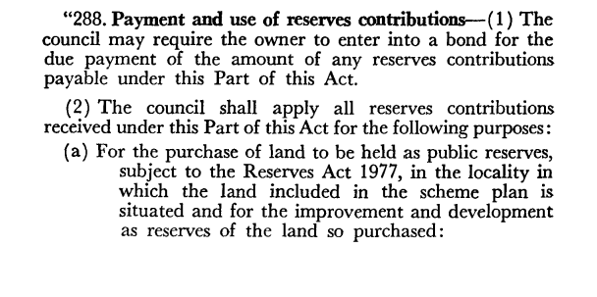

Slide 12
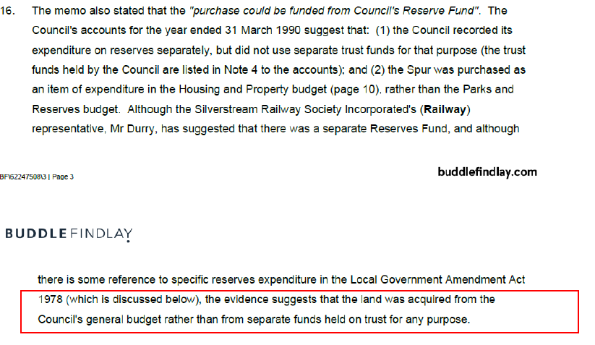
The recent UHCC initiated Legal Opinion attempted to say that the Spur was purchased from the councils “General Budget” rather than from separate funds.

Slide 13
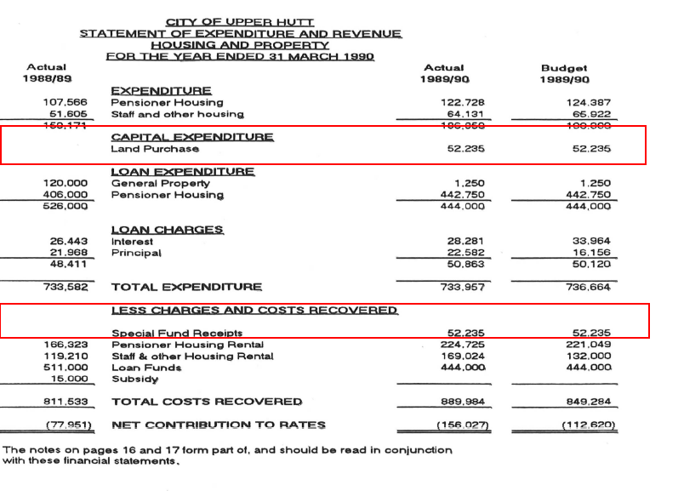
But they missed one minor detail

Slide 14
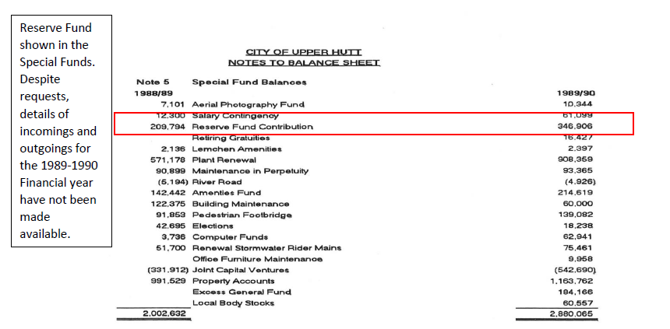
One of the Special Funds being the Reserve Fund Contributions

Slide 15
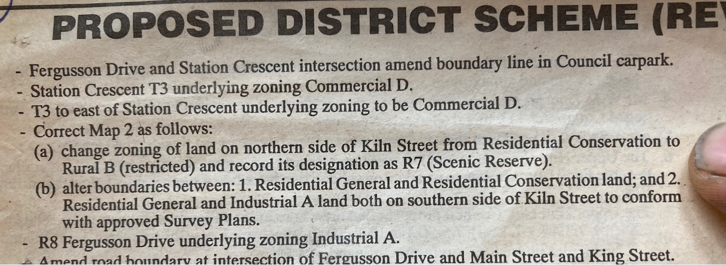
Upper Hutt Leader March 10 1992

Slide 16
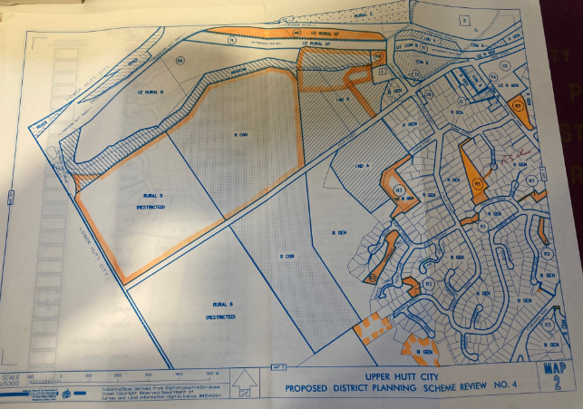

Slide 17
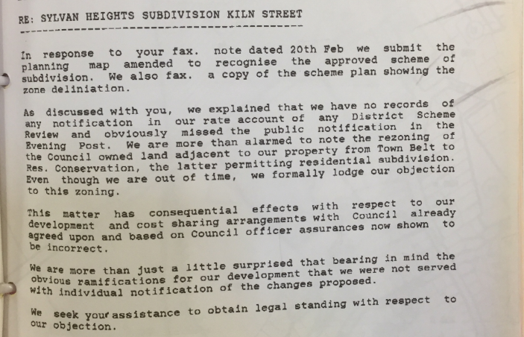
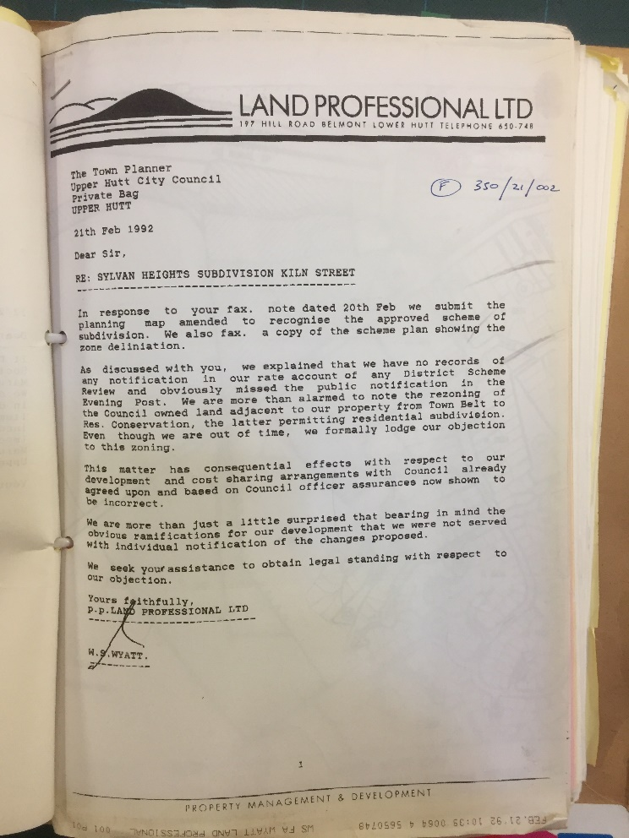

Slide 18
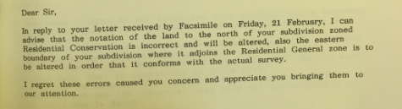
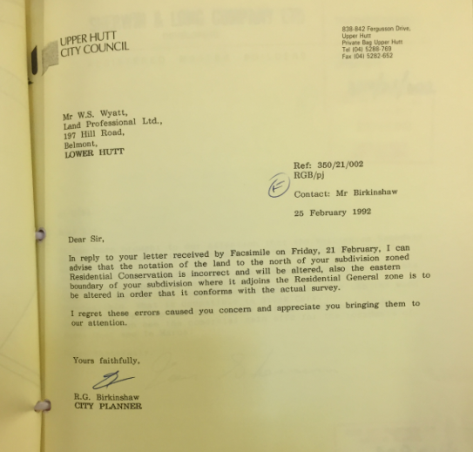

Slide 19
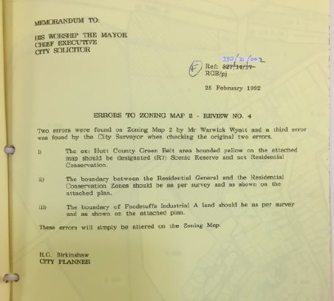

Slide 20
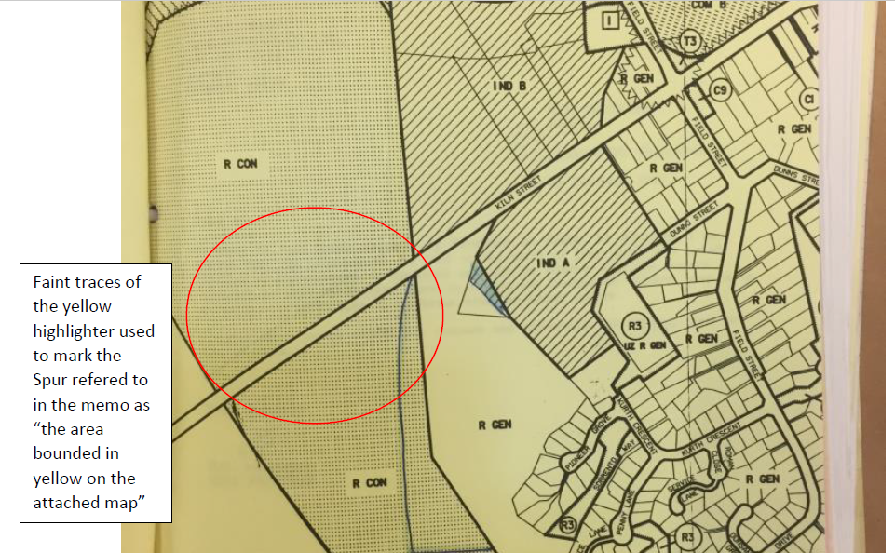

Slide 21

Rezoning Recap
District Scheme review started in 1991
Error on consultation Maps discovered by neighbouring property owner in February 1992
Undertaking to correct the errors given by the City Planner
Correction published in the Upper Hutt Leader March 1992
UHCC now state on their website:

Slide 22
Forestry Era 1993-2001
Resource Consent applied for in January 1994
A 20 meter wide visual and debris stop barrier to be planted in native vegetation around the perimeter of the Spur, which never occurred.
Access to the site for harvesting to be provided from Reynolds Bach Drive. No further roading was to be provided additional to the existing tracks and required upgrades.
“Significant tracts” of existing native vegetation was to be retained and protected from damage
Consent was granted in March 1994

Slide 23
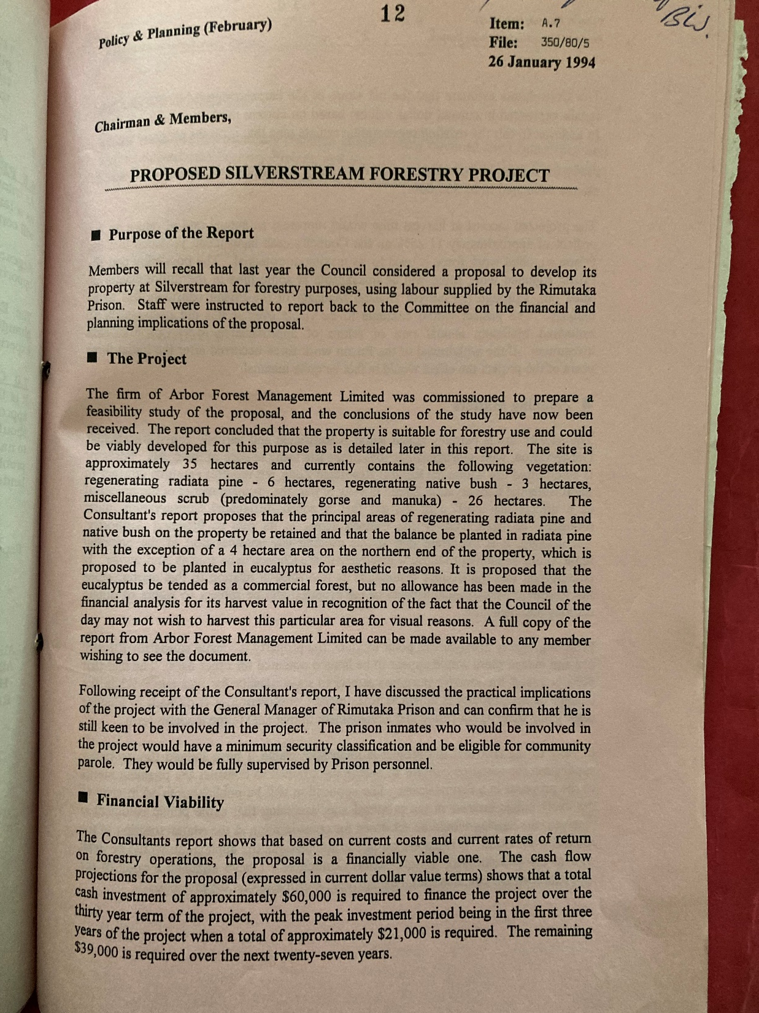
The Forestry project reports and consent application documents mention at length the visual amenity of the Spur, along with its current (at that time) and future recreation potential. It even states that “Upon harvesting in approximately 30 years (2024), if the site is not replanted for a further harvest, then it should be returned to native bush. This would ensure the landscape and amenity value of the site is continued"

Slide 24
A report was put to council in December 2001 that explored 4 options for the Spur :
Sell the land with the Forest. “If retention of control over the visual amenity is not a priority for Council, sale is recommended”
Sell the Forest only, retaining the land. “It is considered though, that it would be very difficult, if not impossible to achieve a sale”
Remove the trees and “farm” the land. “It would also have to be acknowledged that farming is not a good fit with Council Activities”
Change the status of the land and forest. “This approach would leave full control of the visual nature of the Spur and all activity thereon in the hands of Council”

Slide 25
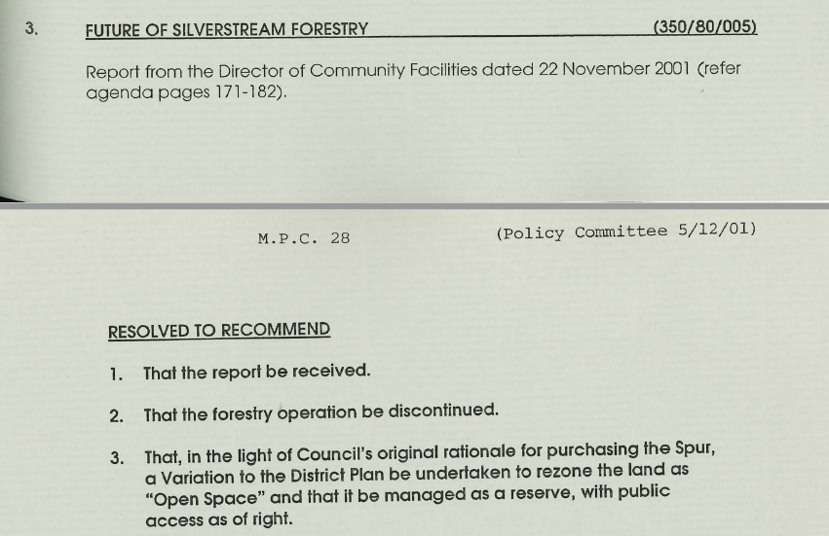

Slide 26
This recommendation was adopted at a Policy Committee meeting on the 5th of December 2001, followed by resolution at a full council meeting on the 12th of December.
By the 20th of December a letter had been sent to the fire service informing them of the decision to remove any financial implication from an insurance standpoint.

Slide 27
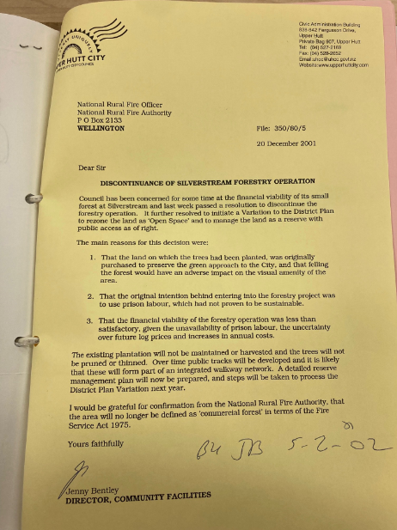

Slide 28
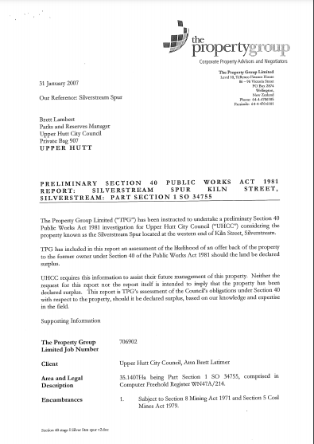
By 2007 it seemed the Spur had really fallen out of favour with UHCC. The abandoned forestry project would be costly to clean up so perhaps disposal might be a good idea after all.
Two reports were commissioned to look at any requirement that the land had to be offered back to its former owners.
The report states that "the council had no particular purpose when the land was purchased“ showing that it was poorly researched.

Slide 29
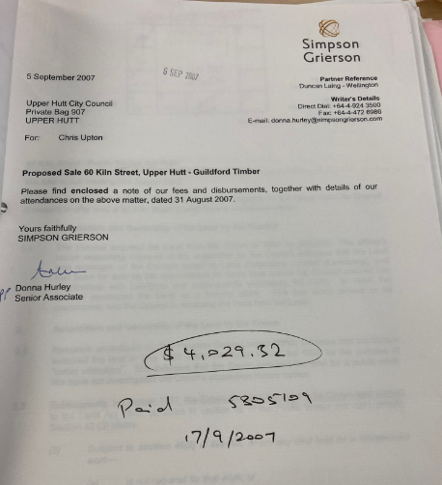
However this was not the only work going on at this time behind closed doors.
Various other valuations, reports and analysis were commissioned by the then CEO, with the outcome looking like a sale to the Guildford Timber company, who at that stage had a signed offer on the table

Slide 30
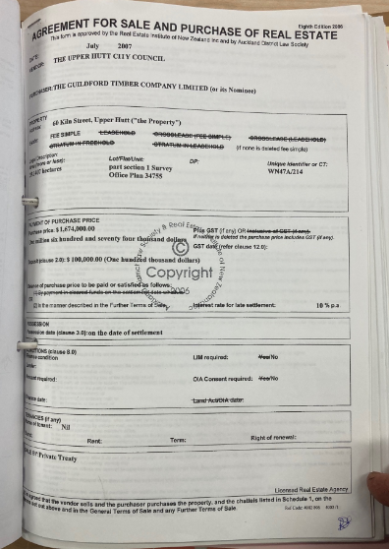
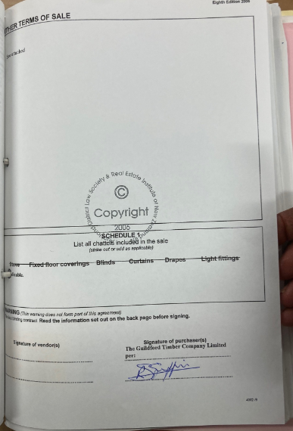

Slide 31
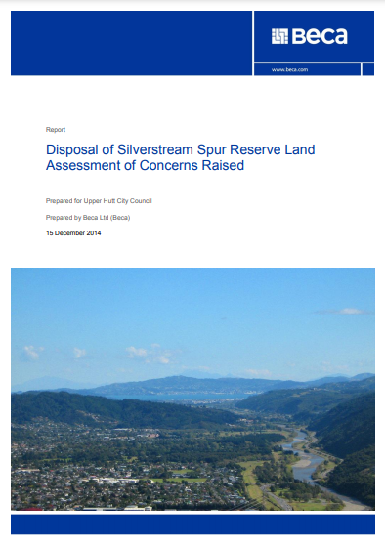
The next report known to be produced by UHCC was after they officially declared the Spur surplus and decided to look at options for selling of the land.
This was in response to the 17 objections to the sale of the Spur land
It is interesting to note that the title of the document again refers to the Spur as Reserve Land.

Slide 32
The MOU (Memorandum of Understanding)
After so much opposition to the proposed sale, Council devised a scheme to give away the entire Spur, for areas of GTC land that was unsuitable for housing, had no access, and had draft SNA designations.
This MOU and Swap had no consultation and was signed with little opportunity for the public to make any comment on it, being presented and discussed during public excluded parts of council meetings.
UHCC spent tens of thousands of dollars obtaining valuations for the Spur, yet ultimately the MOU amounted to nothing

Slide 33
Infrastructure Acceleration Fund Application
In August 2021 UHCC held a public excluded meeting to discuss the application for central government funding to enable the construction of a road/infrastructure corridor on the Silverstream Spur.
The application would have included costings and designs including the proposed location for the road and utility infrastructure
The application made it past the first round as most applications did and after more work it was declined by Kaianga Ora

Slide 34
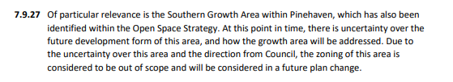
Plan Change 49 Round 1 (2021)
As part of the rolling review of the District plan, Council staff put out for consultation a Open Spaces Plan Change seeking to rezone specific areas of the city into 3 types of open space zones.
However the Silverstream Spur was deemed “out of scope”

Slide 35
11 submissions specifically requested that the Spur be zoned as a form of Open Space, with a large amount of supporting evidence presented including a number of petitions.
45 Further submissions in support of these original submissions were also presented, at least 6 specifically objecting to the construction of a road on the Spur, with one (GTC) opposing any parts of submissions which sought to restrict development of the Spur.

Slide 36
Plan Change 49 Round 2 (2022)
Proposal to Rezone the entire Spur as Natural Open Space
Allow provision of a road/infrastructure corridor of any size, shape and area, on any part of the Spur.
Depending on the area the road/infrastructure corridor could be located it may be possible for it to be undertaken without requiring any further consultation.
Initial work by council on the variation talked of the road being in a known location and of known size requiring a different set of rules, but this was changed to now allowing it to occur anywhere on the Spur.

