Slide 1
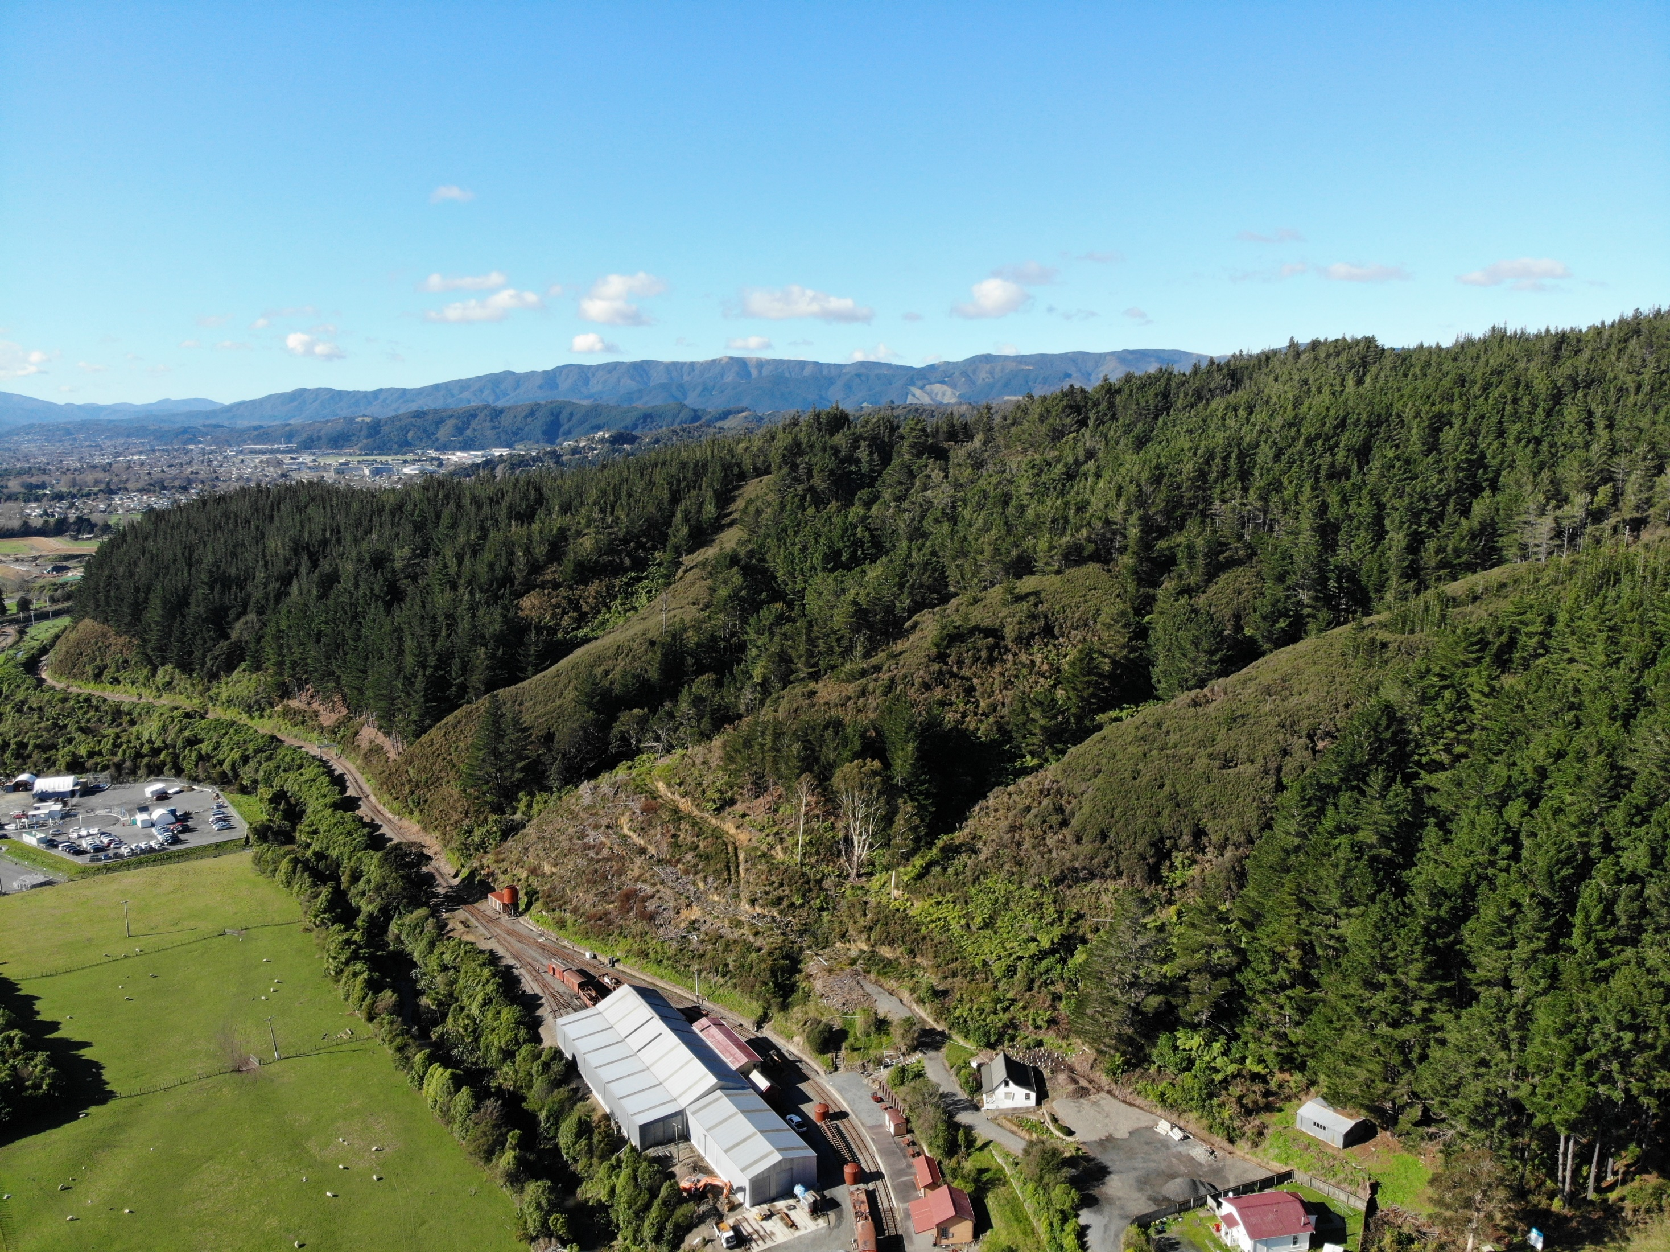

Silverstream Spur
Saving a public amenity for future generations

Slide 2
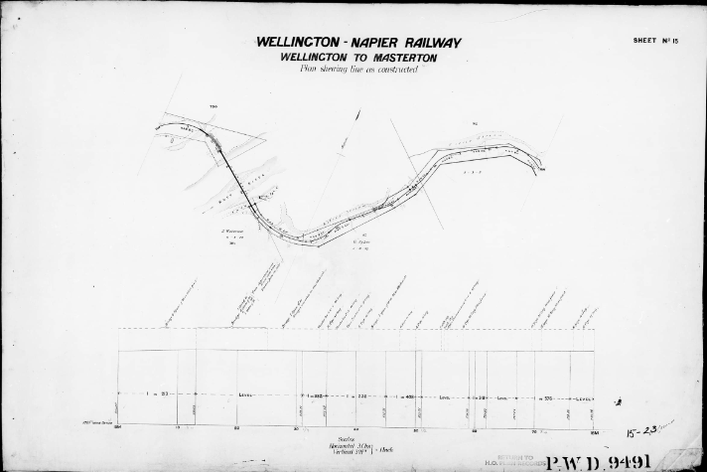

Construction of the Wellington to Upper Hutt Railway commenced in August 1872
Silverstream Spur

Slide 3
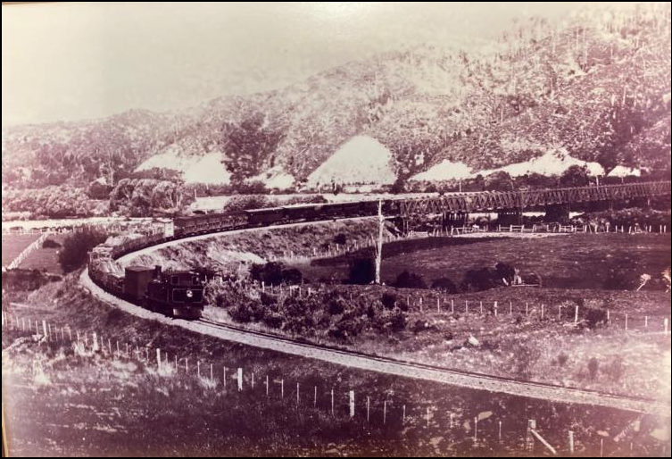
The first train ran to Lower Hutt on the 14th of April 1874.
Silverstream Spur

Slide 4
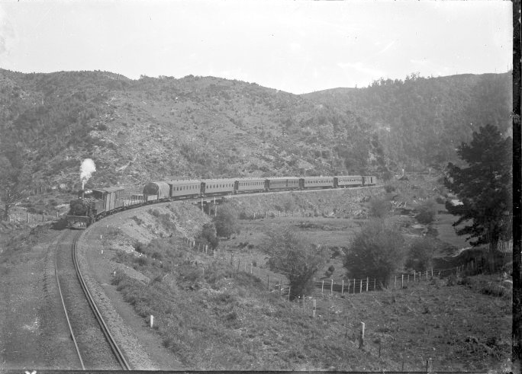
The railway to Silverstream opened in December 1875 with Upper Hutt reached on the 1st of February 1876.

Slide 5
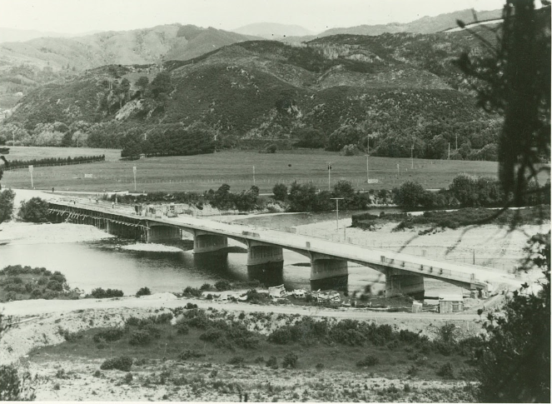
The Silverstream Spur and some of the surrounding area were acquired by the crown in the 1940s to enable the upgrade of the Hutt Valley Railway

Slide 6
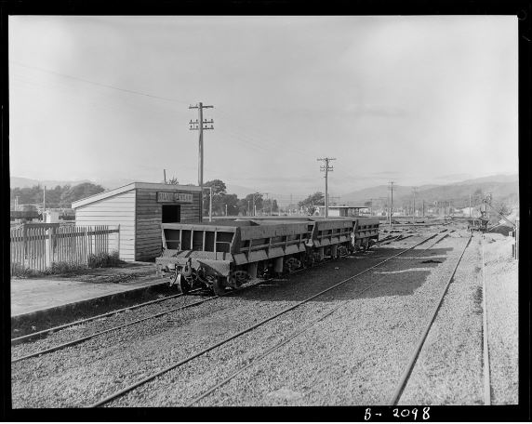
Trains ran over this section of track that is now Silver Stream Railway until November 1954 when the new (current) line was brought into use.
The line was bypassed as the bridge over the Hutt River and the narrow formation were unsuitable for electrification and duplication.

Slide 7
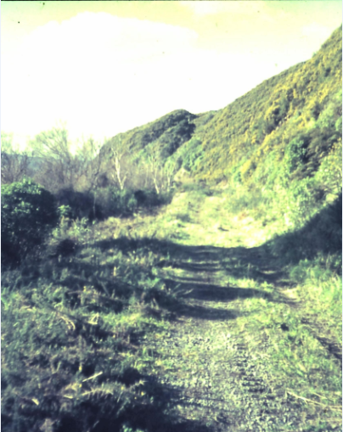
All remnant's of the old line were removed, track, bridges, and lineside features.

Slide 8
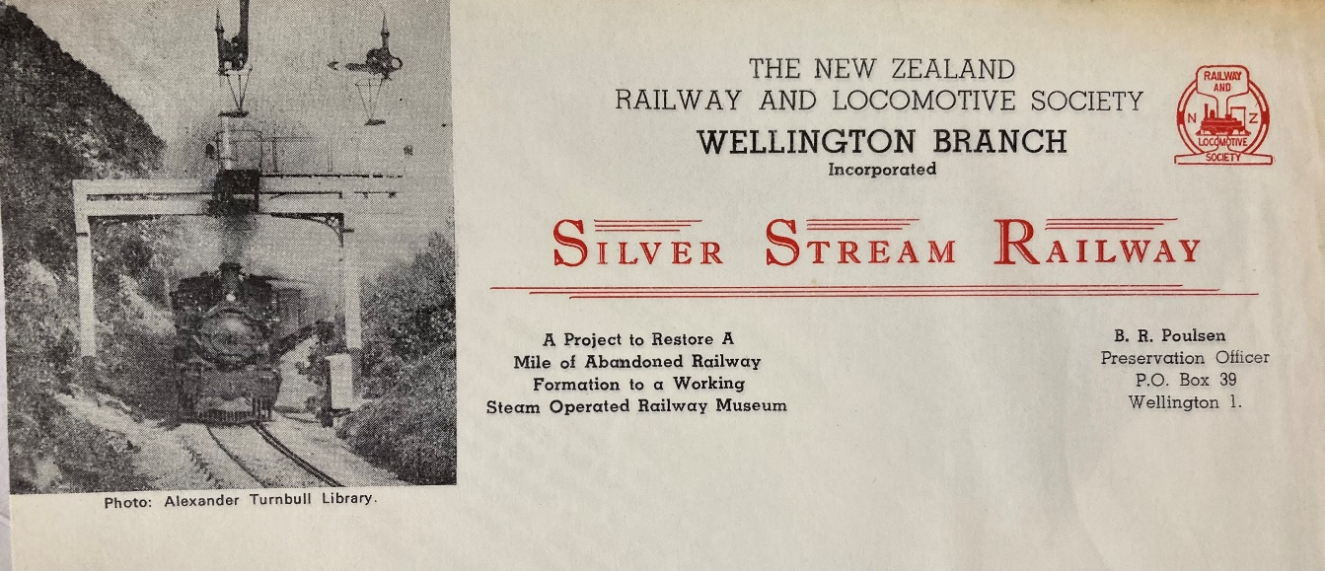
Silver Stream Railway Incorporated
Formed in 1956 as a group of people interested in railways.
Became an Incorporated Society in 1967 when focus turned to preserving the rapidly changing railway scene at that time.
First locomotive (Ka935) purchased in February 1968 from New Zealand Railways for $1200.
Search for a permanent home settled on ‘a mile of abandoned railway’ near Silverstream in Upper Hutt.

Slide 9
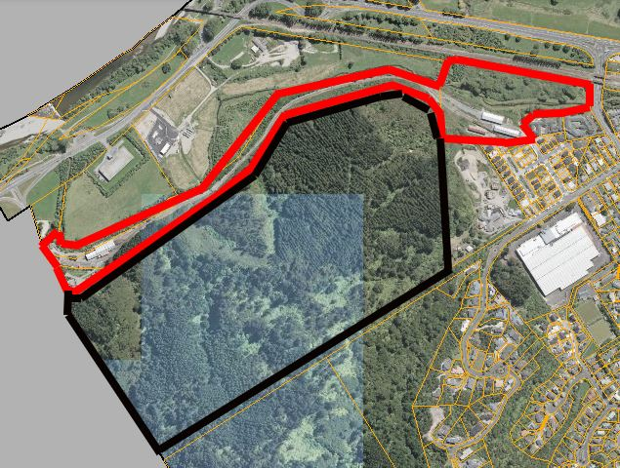
After years of negotiations with the Department of Lands and Survey an agreement was reached which allowed occupation of the site from 1974 with the sale concluded in 1978 for the former railway corridor.
Other parcels of land have been added to the property over the years with total freehold land now totalling over 9 hectares.

Slide 10
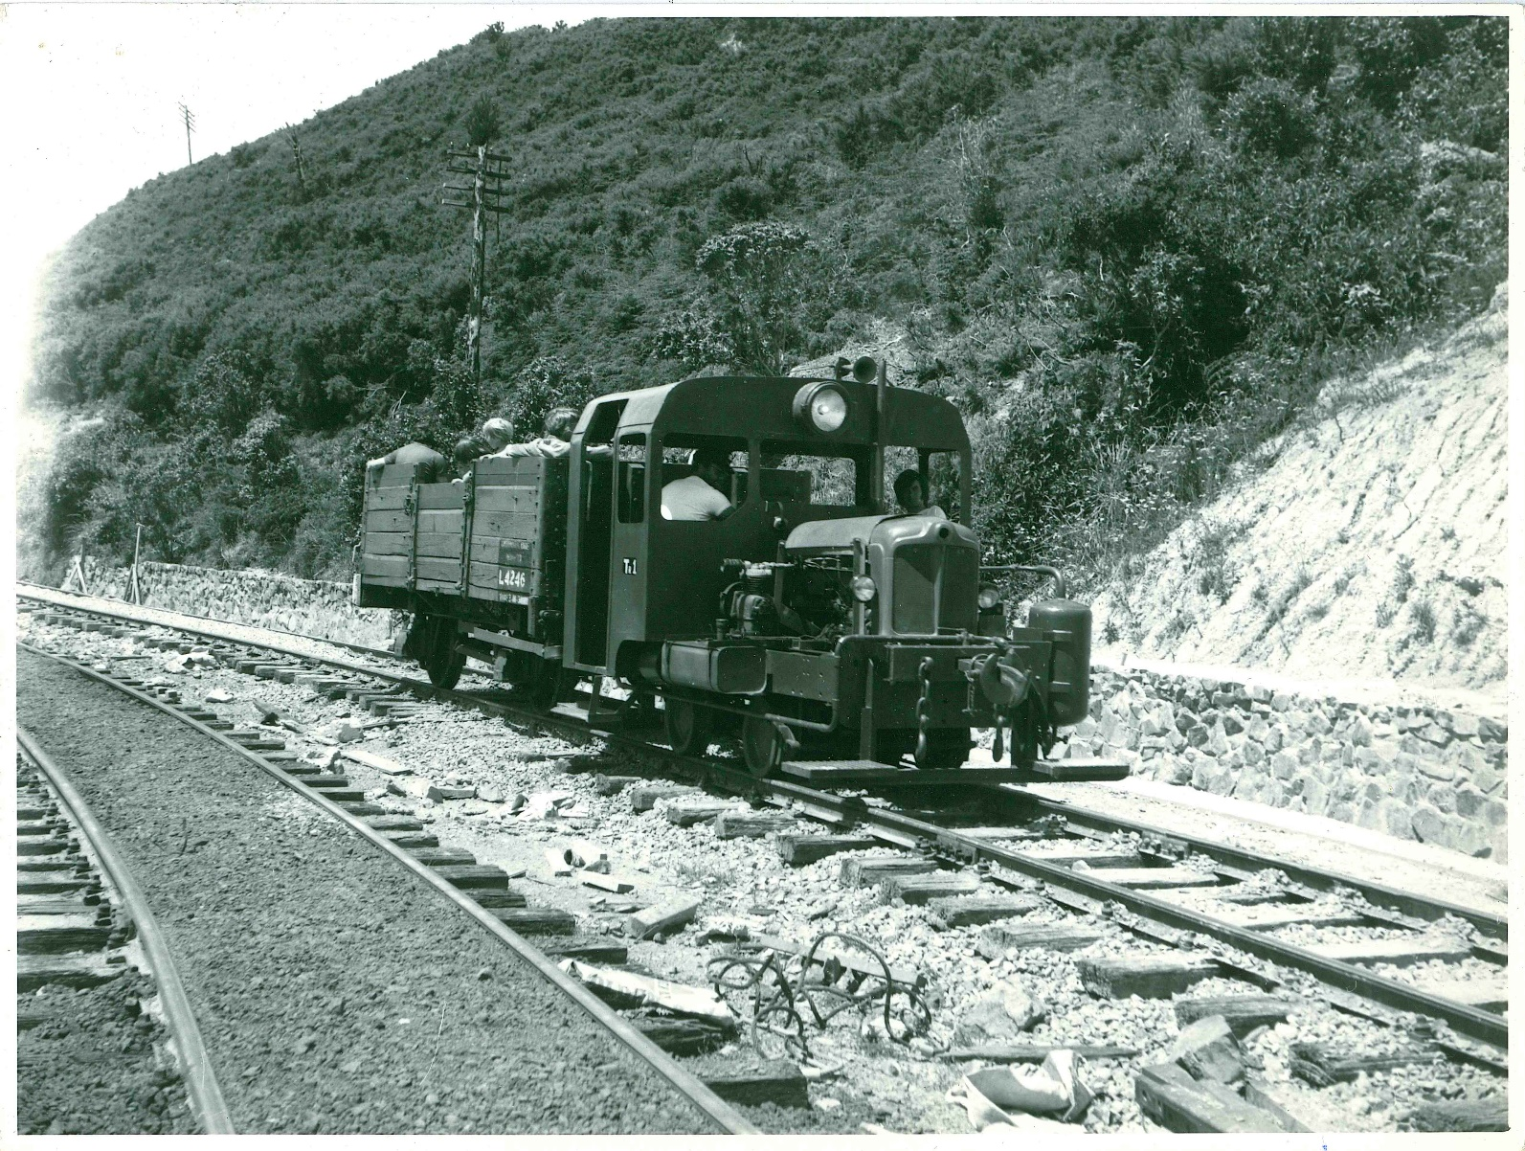
The first public rides were offered in December 1978 using a small diesel shunter and open wagon.
Very conservative estimates put the number of passengers carried at well over 200,000 since 1978.

Slide 11
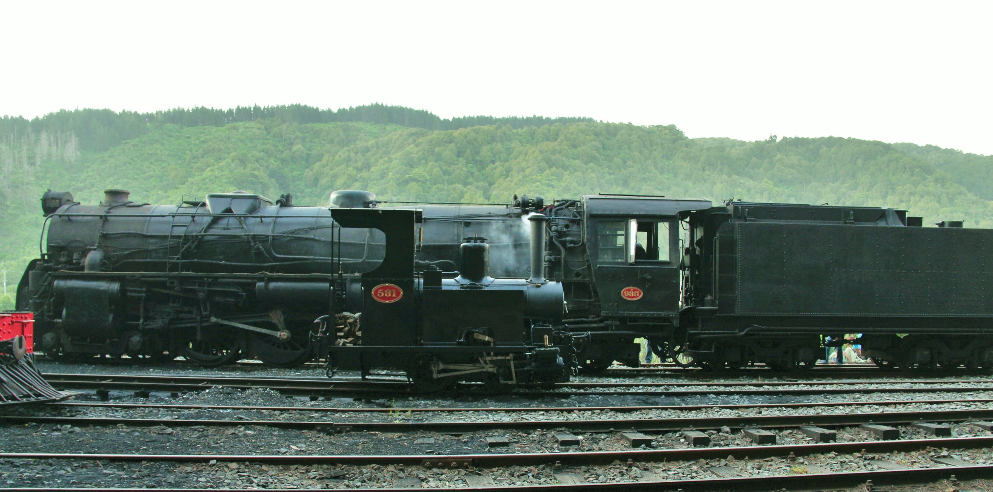
The railway now boasts one of the most comprehensive collections of equipment in New Zealand, ranging in age from an 1874 steam locomotive to a 1998 built Ballast Regulator.

Slide 12
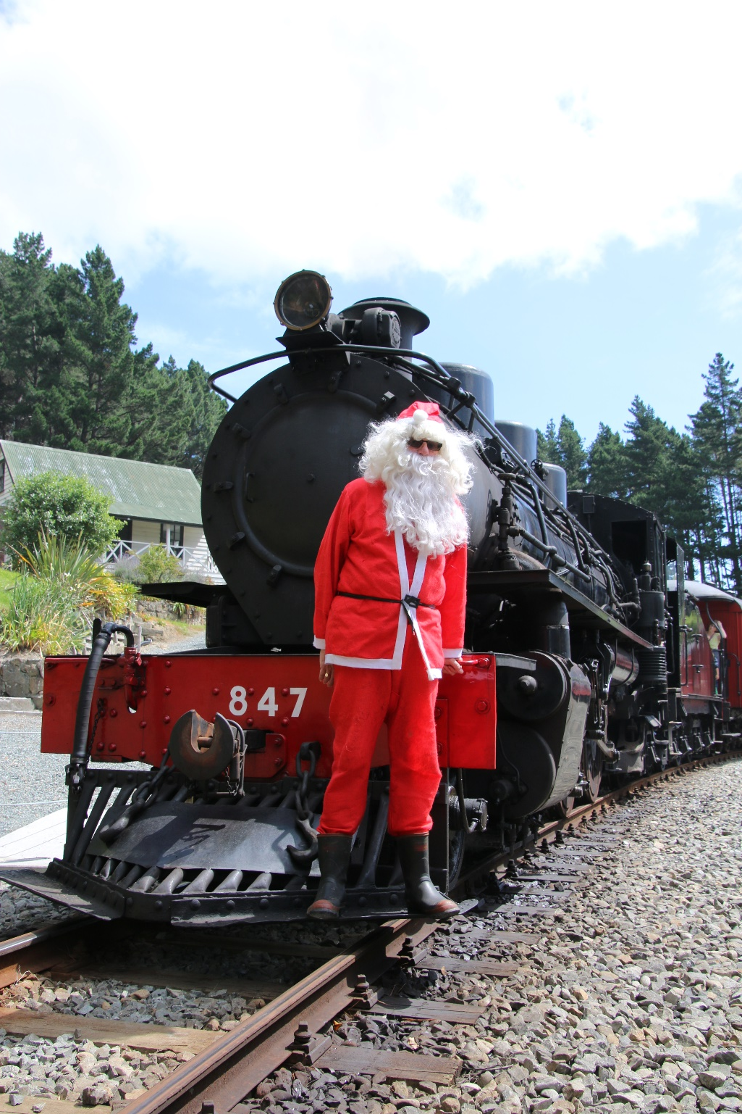
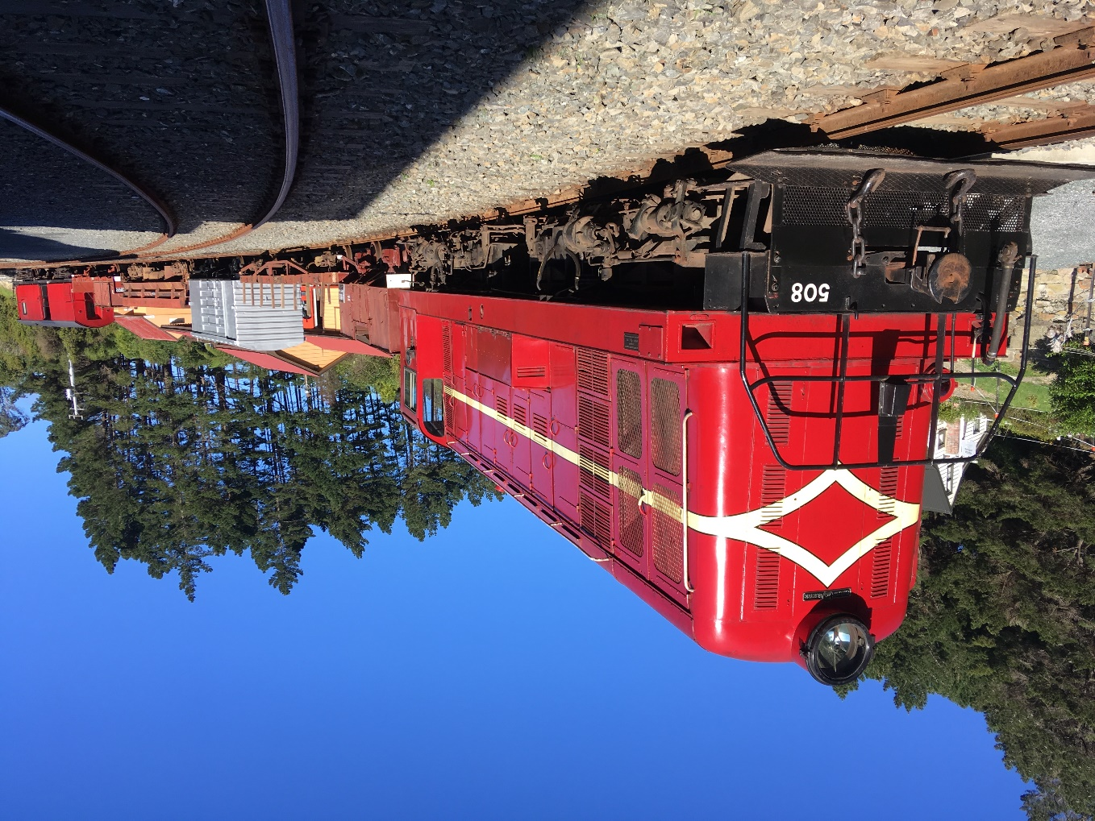
Our public operating days are the 1st and 3rd Sunday of the month and selected public holidays, with several special event days held throughout the year.

Slide 13
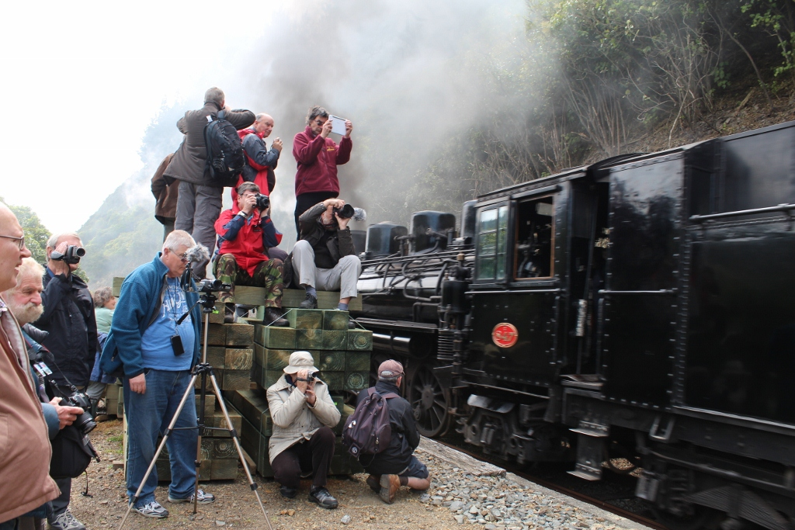
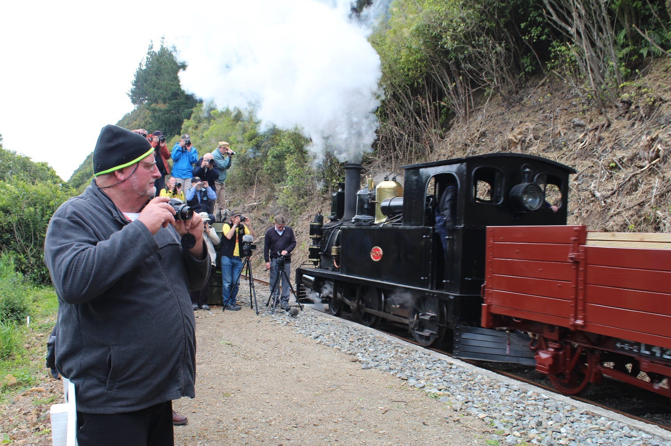
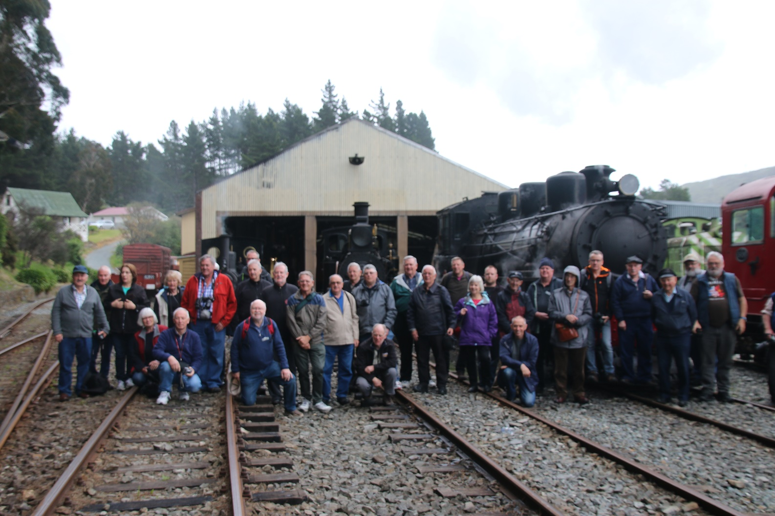
Special Charters are run for organised railfan tours by overseas railway enthusiast groups, giving the chance to showcase the railway to an international audience.

Slide 14
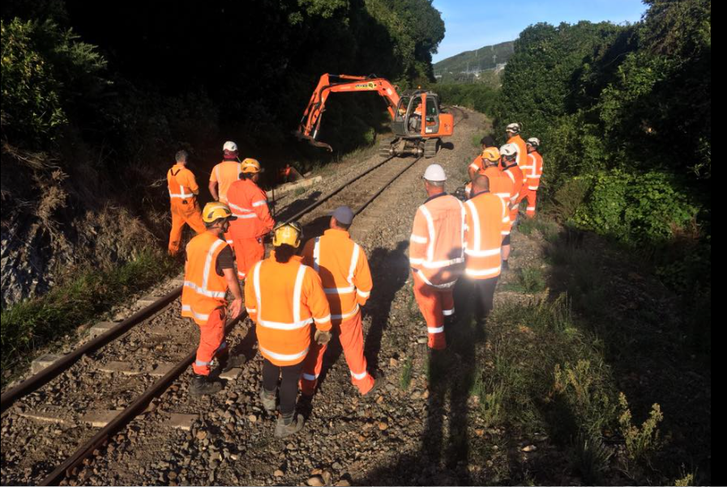
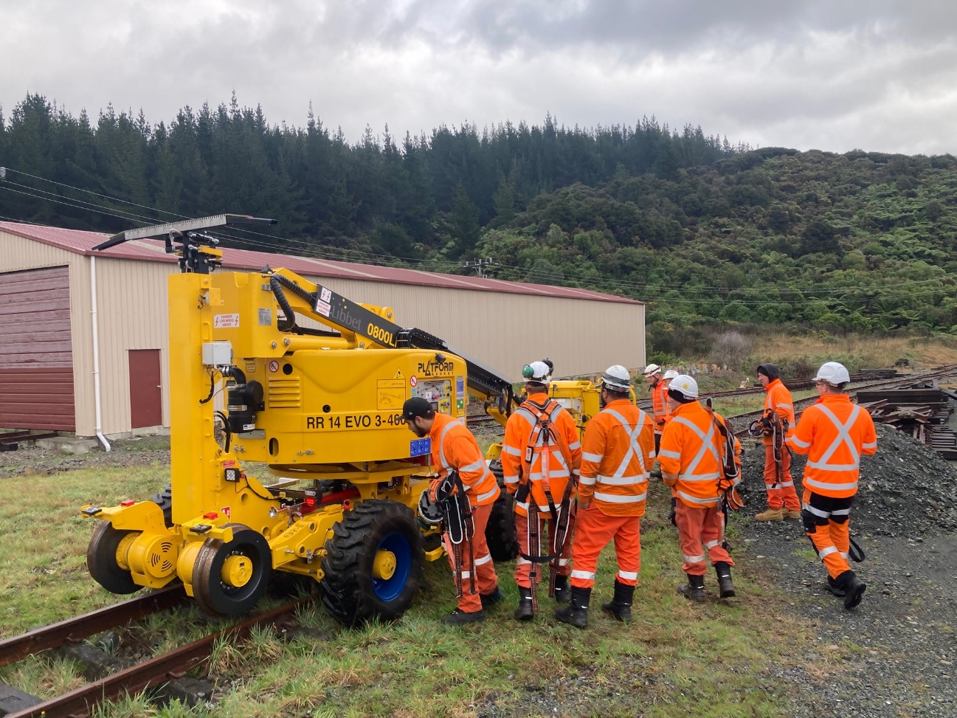
Provision of a facility to enable training of infrastructure staff and testing of equipment, something not easily possible on the KiwiRail Network due to the frequency of trains in the Metro Area.

Slide 15
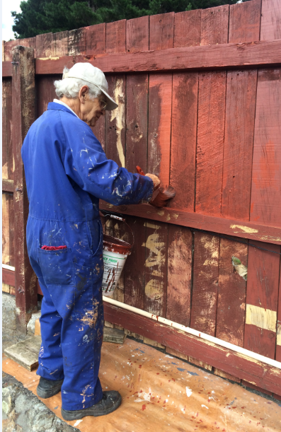
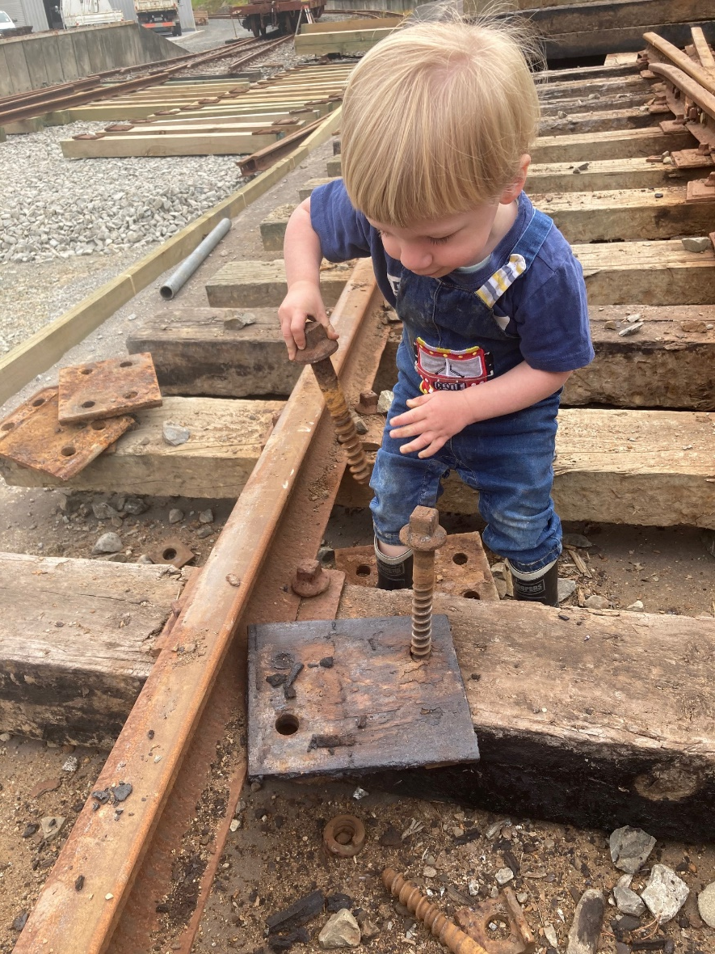
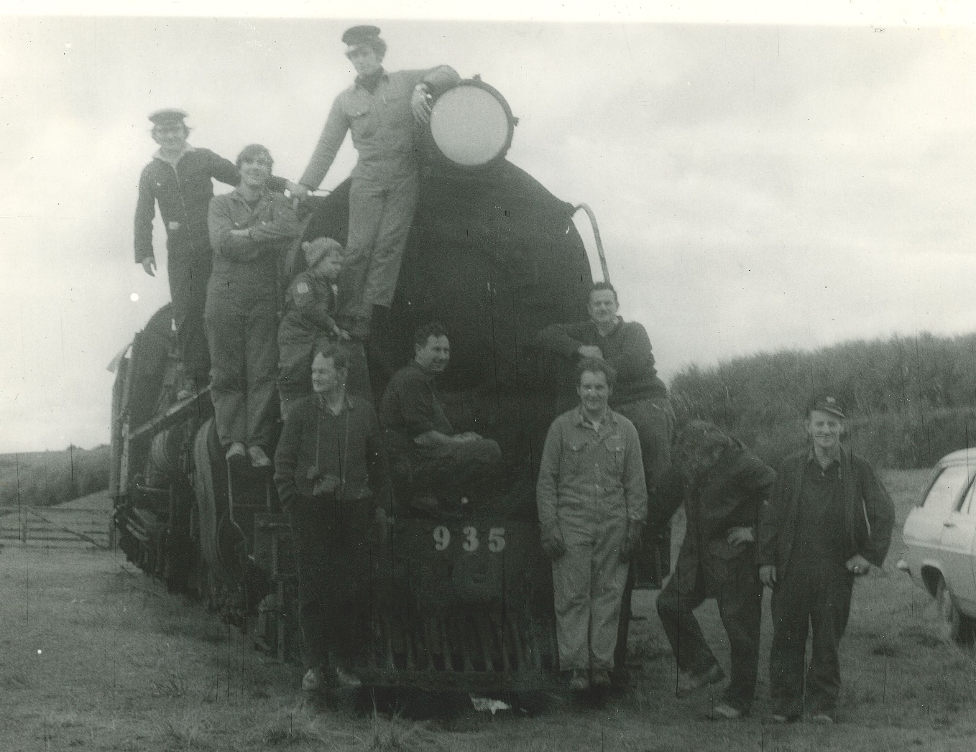
Contributions to the community and the environment
A creative outlet for volunteers, young to old for over 50 years

Slide 16
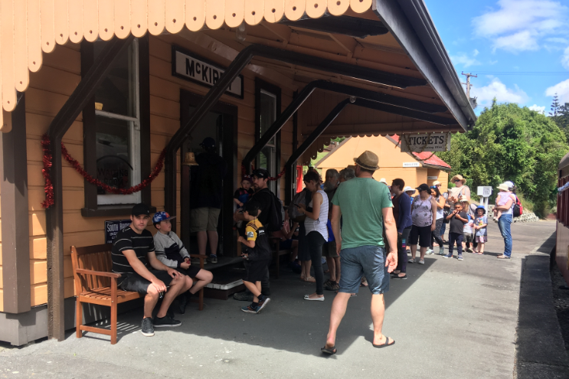
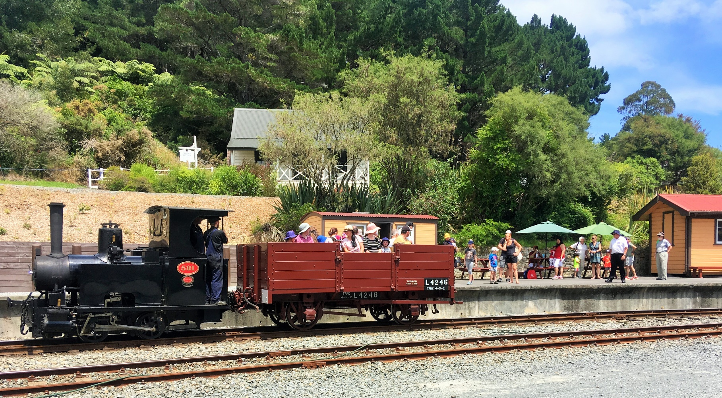
A standalone self supporting attraction which brings thousands of visitors to the city every year including many that would otherwise not visit Upper Hutt.

Slide 17
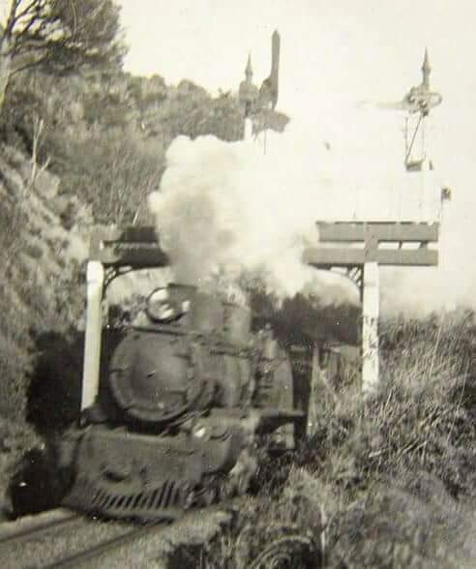
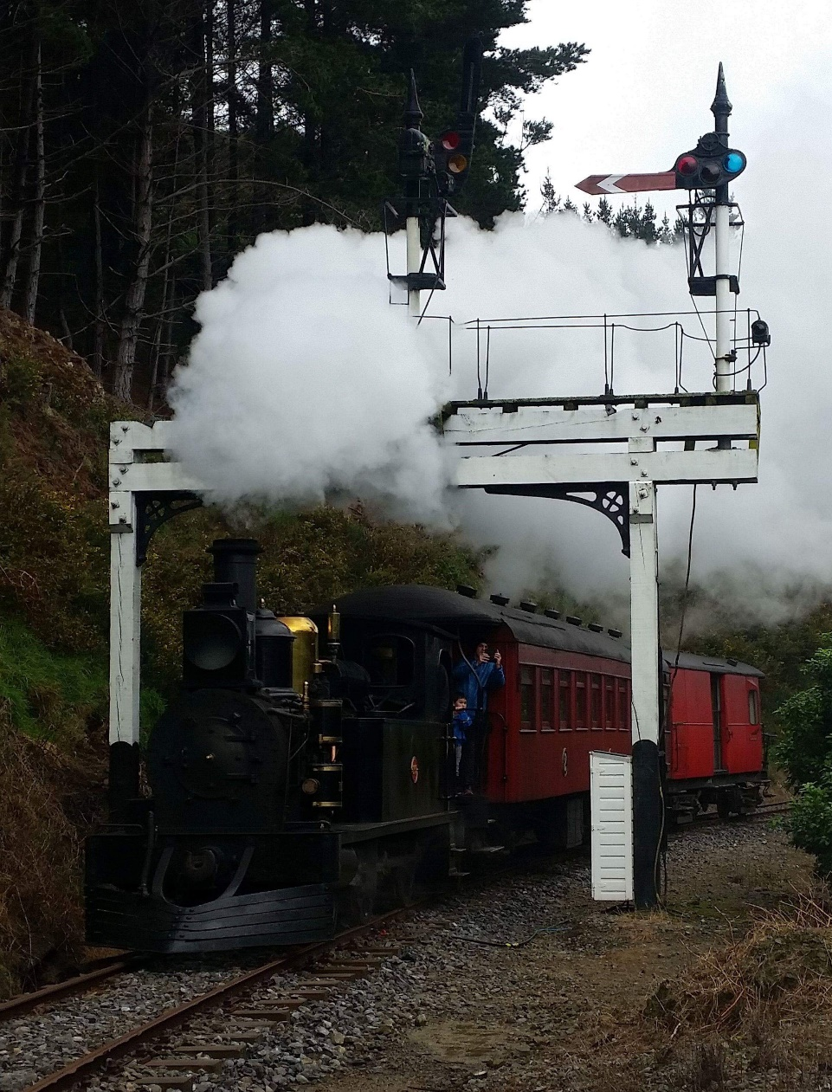
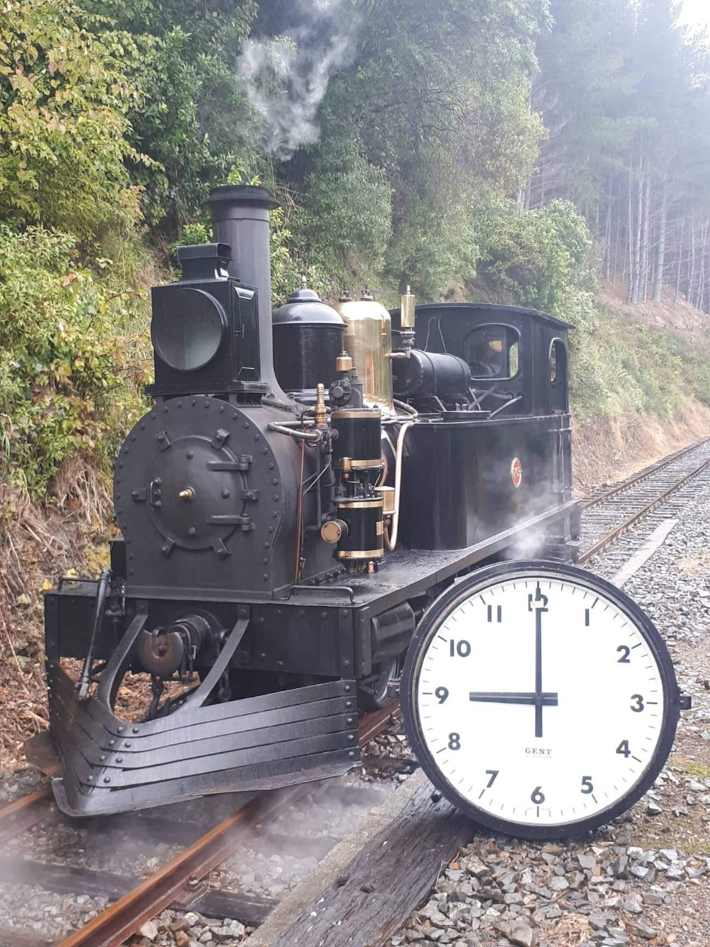
The preservation of New Zealand’s cultural heritage. Everything from locomotives to clocks and most things in between.

Slide 18
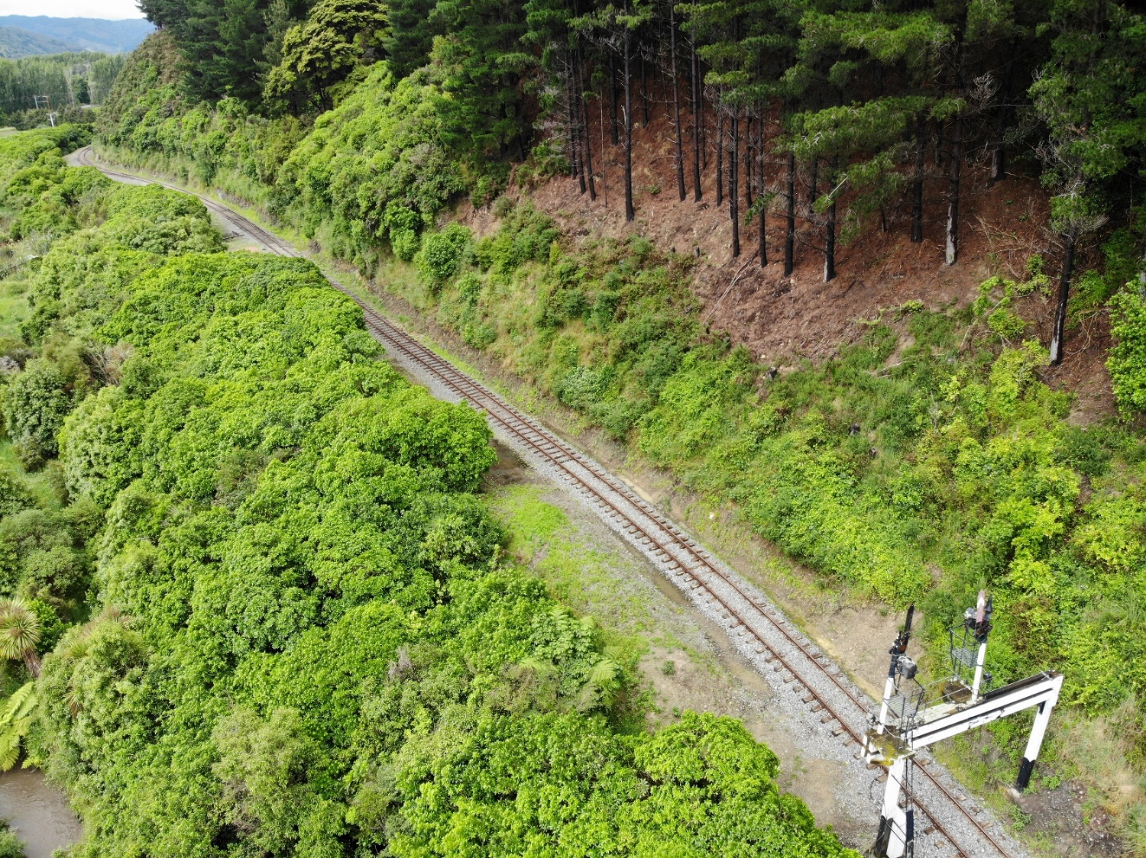
Preservation of what is now the only remaining section of railway in the Greater Wellington Region which still retains its original purpose, original setting, and in the most part uses formation that is unchanged from when constructed in the 1870’s

Slide 19
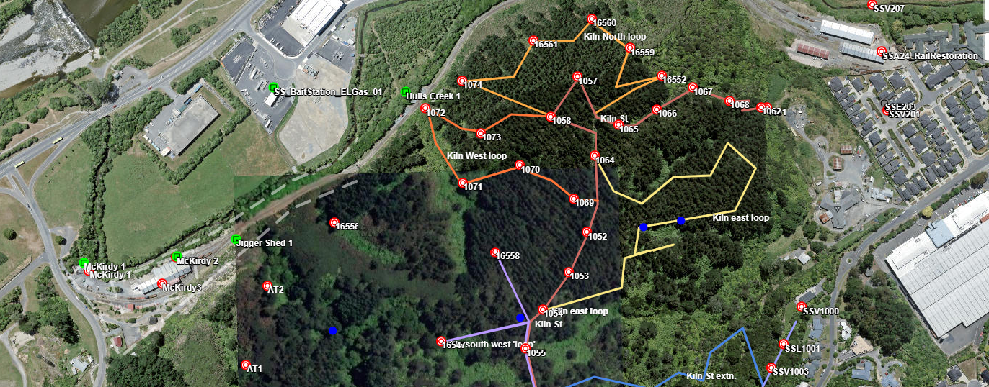
Contribution to pest control on the railway’s property and in collaboration with Pest Free Upper Hutt on the Silverstream Spur

Slide 20
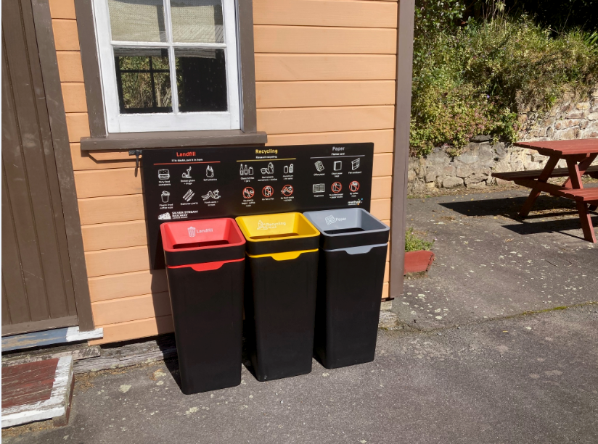
Thanks to a UHCC Waste Minimisation Grant we are now able to divert rubbish away from Landfill

Slide 21
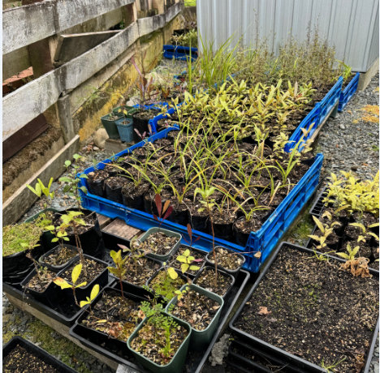
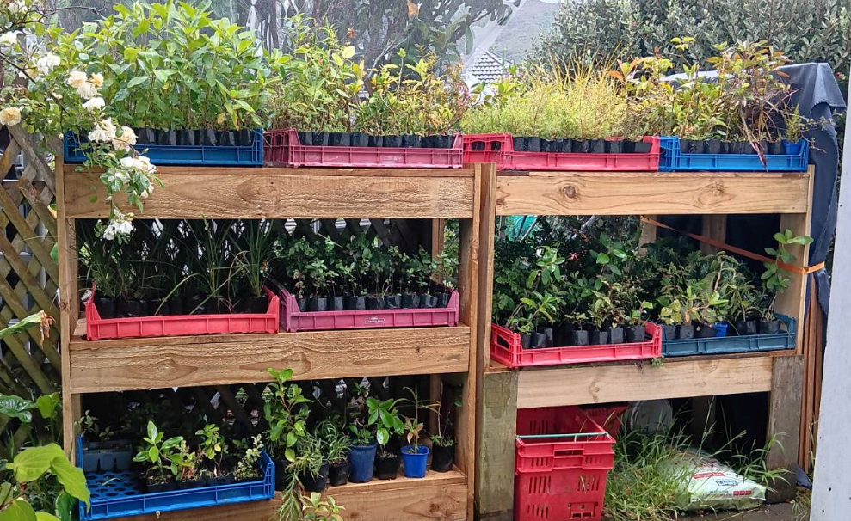
Restoring indigenous biodiversity with native vegetation grown by members at two nursery's, each capable of producing approximately 1000 plants per year

Slide 22
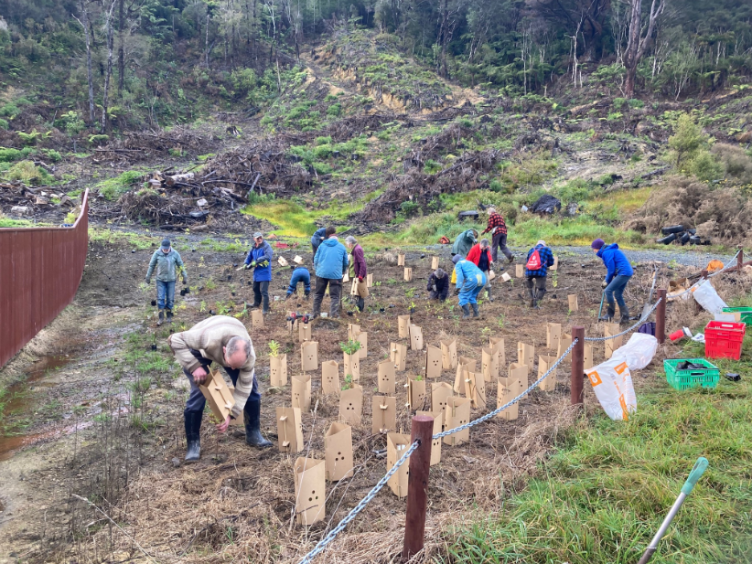
Planting projects often in collaboration with Forest and Bird Upper Hutt

Slide 23
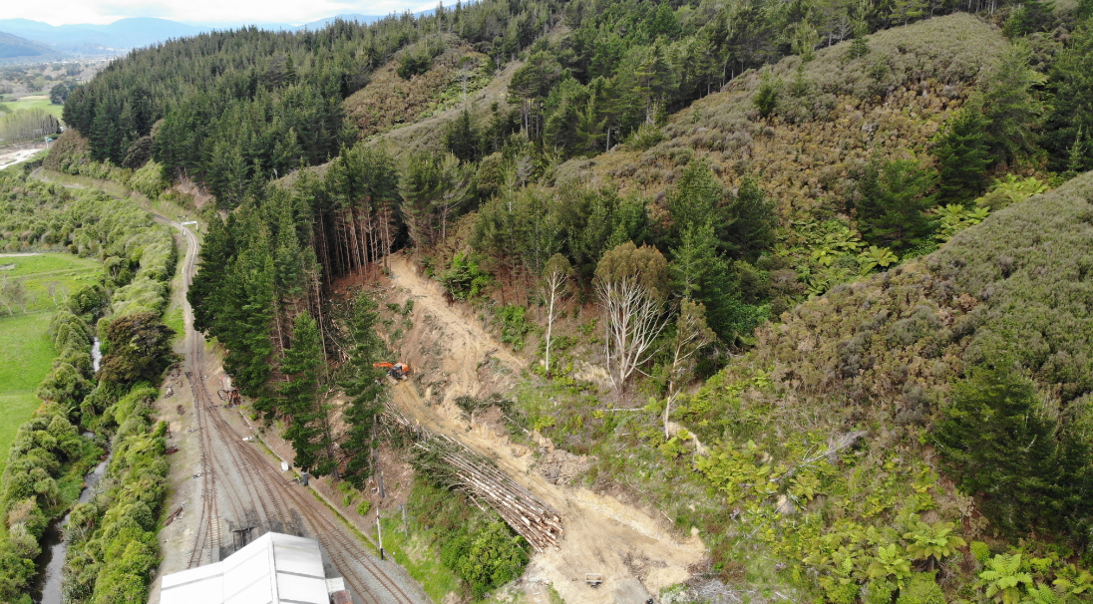
Removal of exotic and pest vegetation species from Railway property

Slide 24
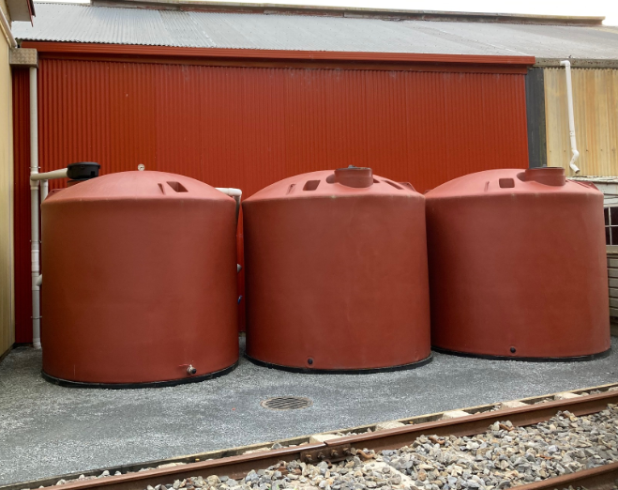
Rain water harvesting to reduce reliance on town supply, enabled with the assistance of a UHCC Sustainability Stimulus Grant.

Slide 25
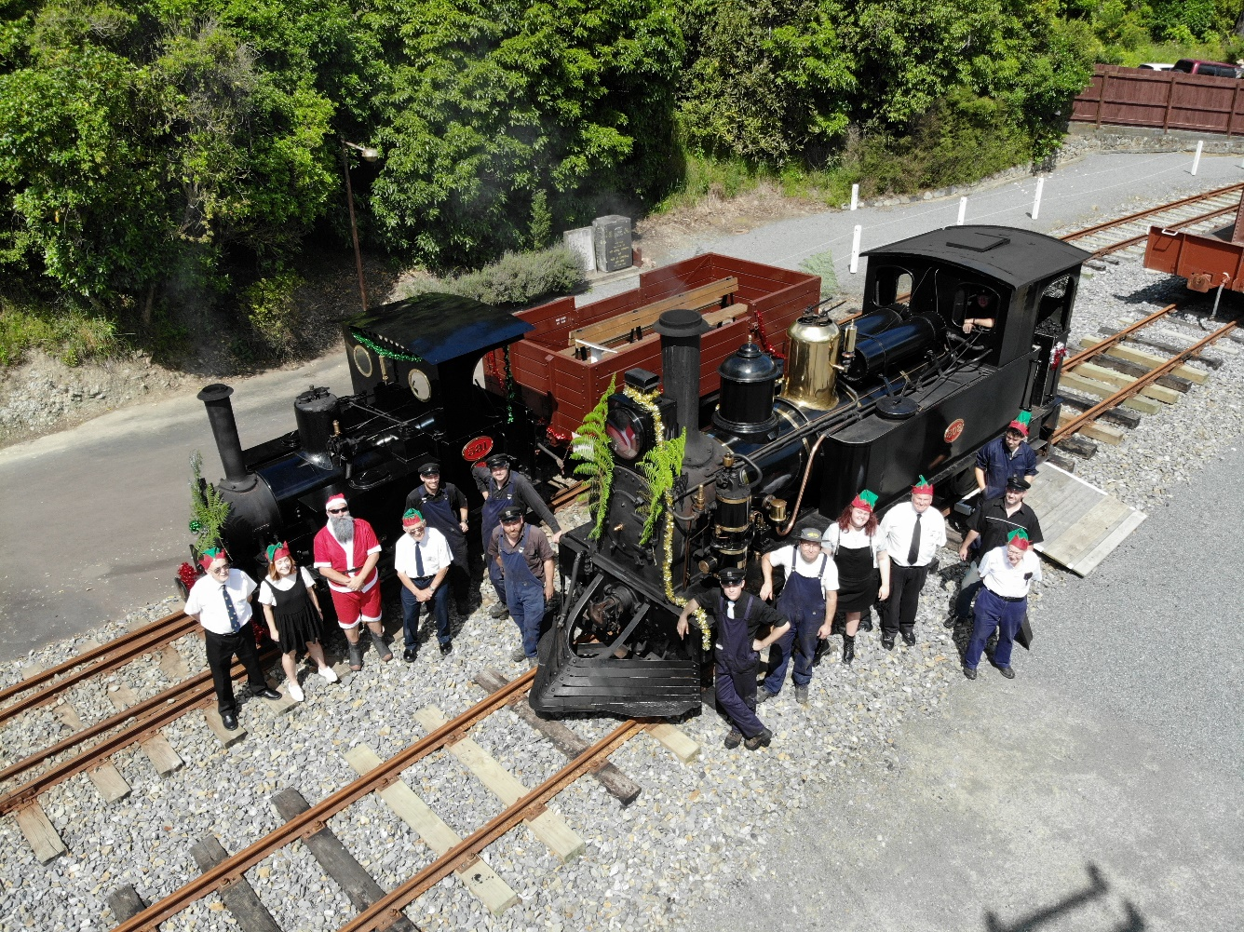
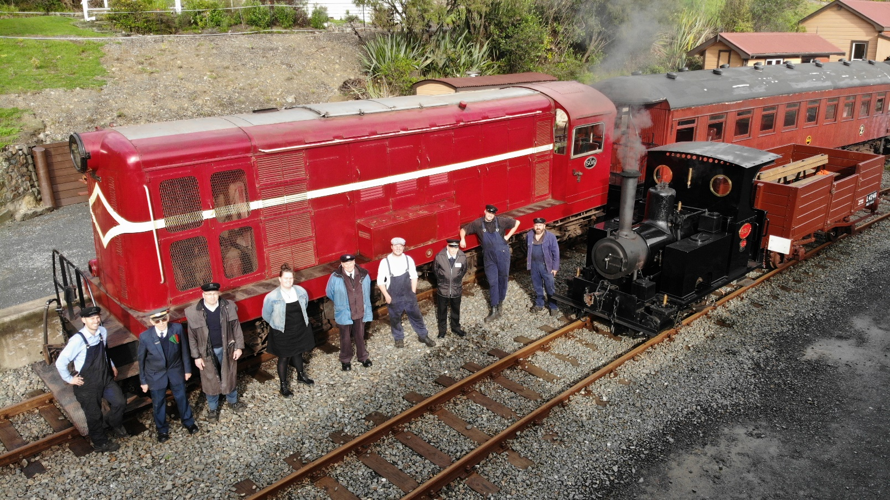
The railway and its members continue the founding objectives, 56 years after it came into being, and plan on preserving the rich railway heritage of New Zealand for many more years on a site with 148 years of history.

Slide 26
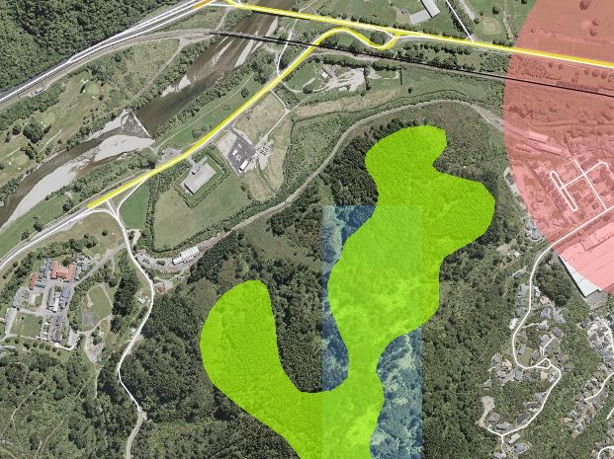
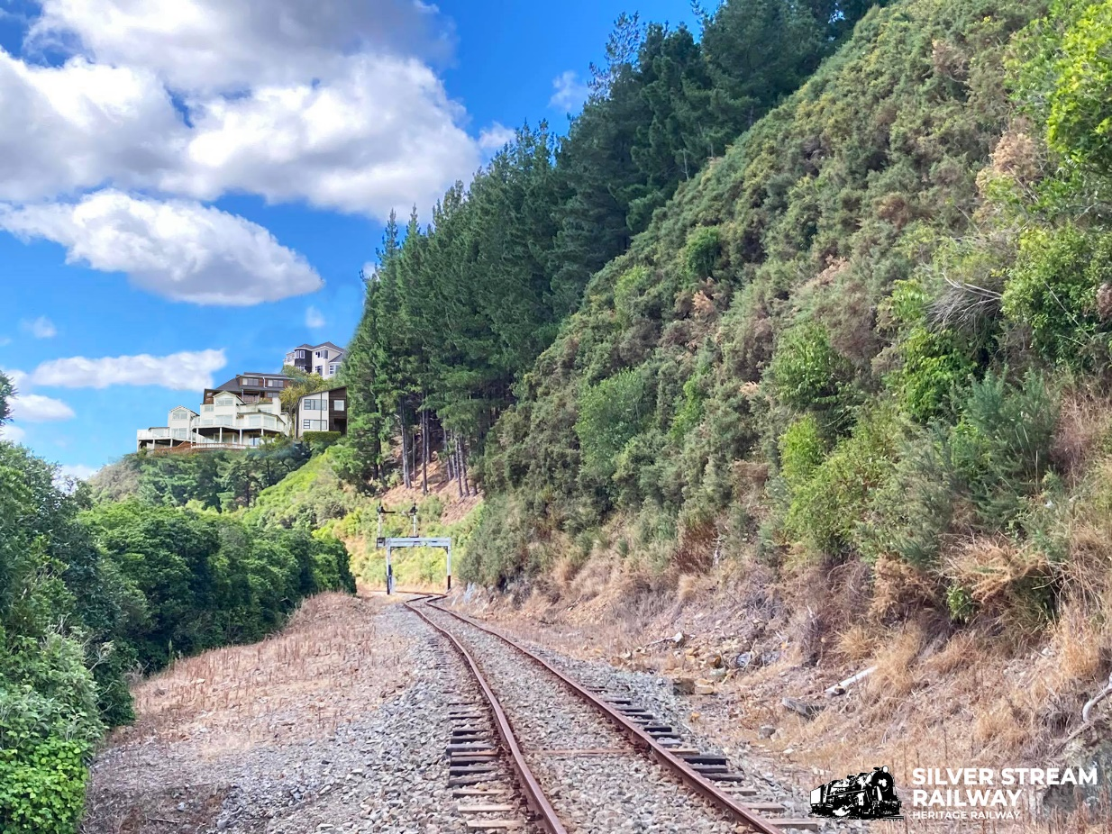
Protection of the Silverstream Spur
Preservation of the Silverstream Spur in its current undeveloped state is vital for Silver Stream Railways future viability and continued operation.

Slide 27
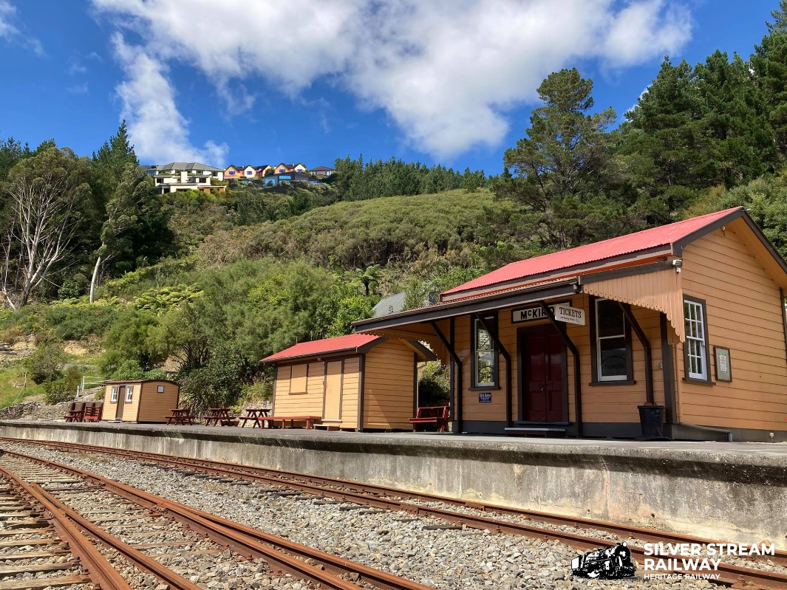
The spur forms an important backdrop to both the railway and also the southern entrance to the city and has been recognised as such for many years. Having houses and/or a road and associated infrastructure on the Spur would significantly detract from these amenities from both the railways viewpoint and that of the community the land was purchased for.

Slide 28
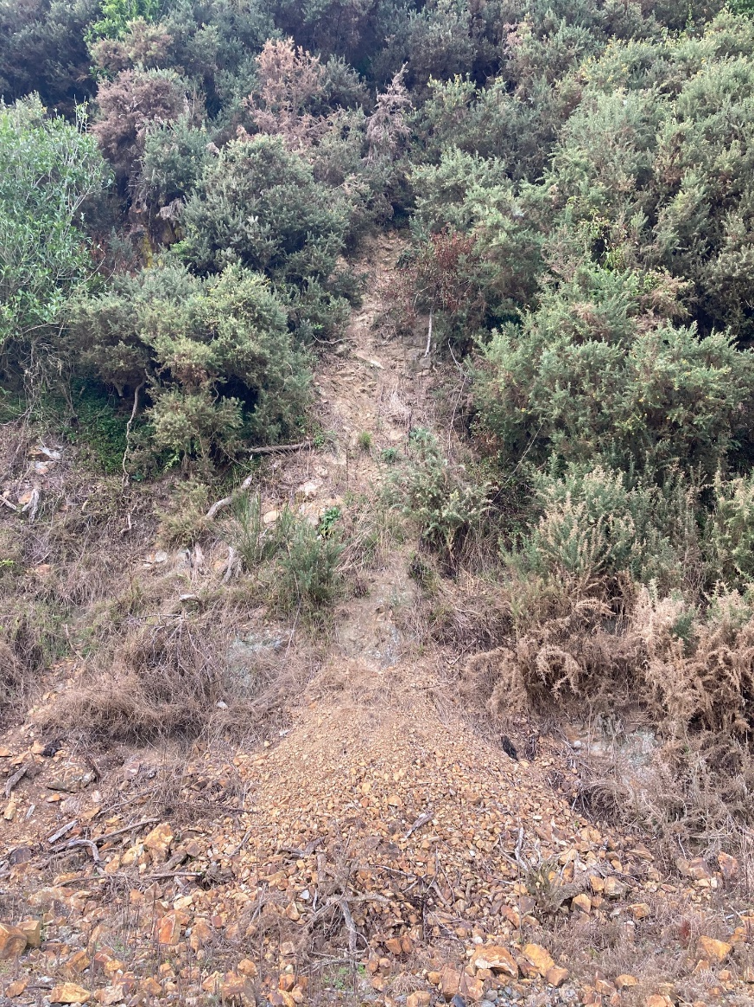
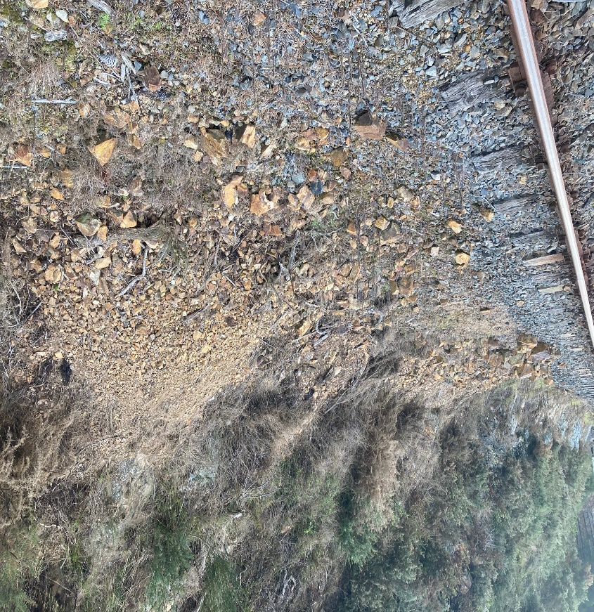
Land stability problems
Spur faces predominantly clay and highly weathered greywacke giving stability issues.
Vegetation cover assists with mitigating risks from slipping, but where this has been cleared (tree removal or fire) the risks markedly increase.
With the good cover of vegetation currently on the spur slips are less of a problem they have been in the past.
Any work on the spur will have an adverse effect on the steep cut faces above the railway.

Slide 29
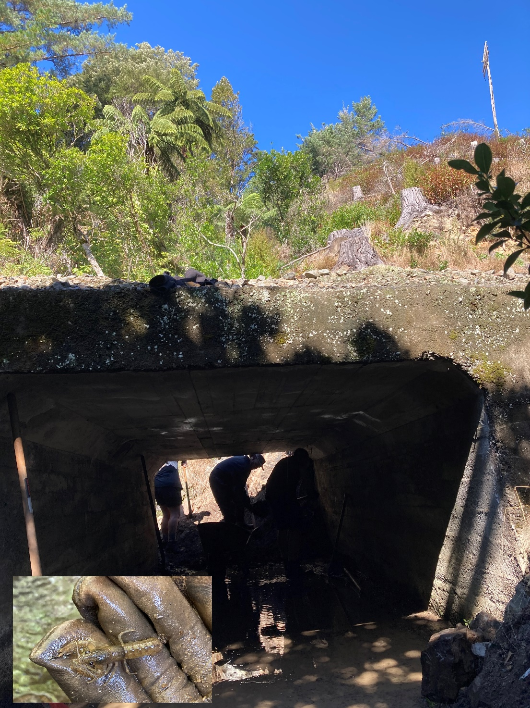
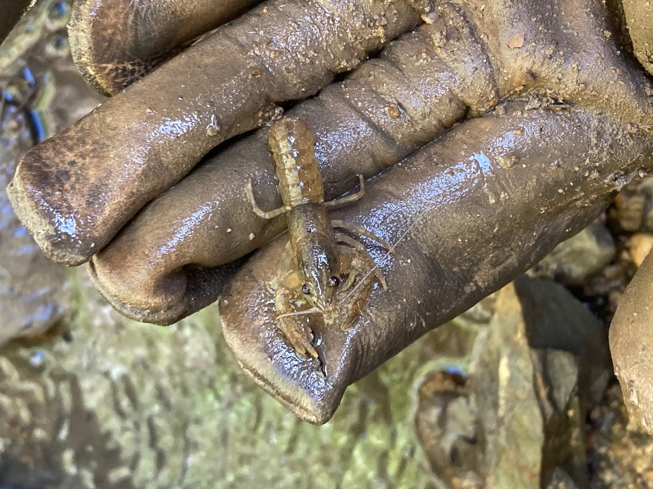
Stormwater
Despite there being a number of water courses that meet the GWRC definition of a stream, they have been omitted from any map, plan or assessment of the spur.
Boffa Miskell Ecological report states that “no permeant aquatic systems and no habitat for fish” on the spur land.
Several of these streams are home to native freshwater crayfish

Slide 30
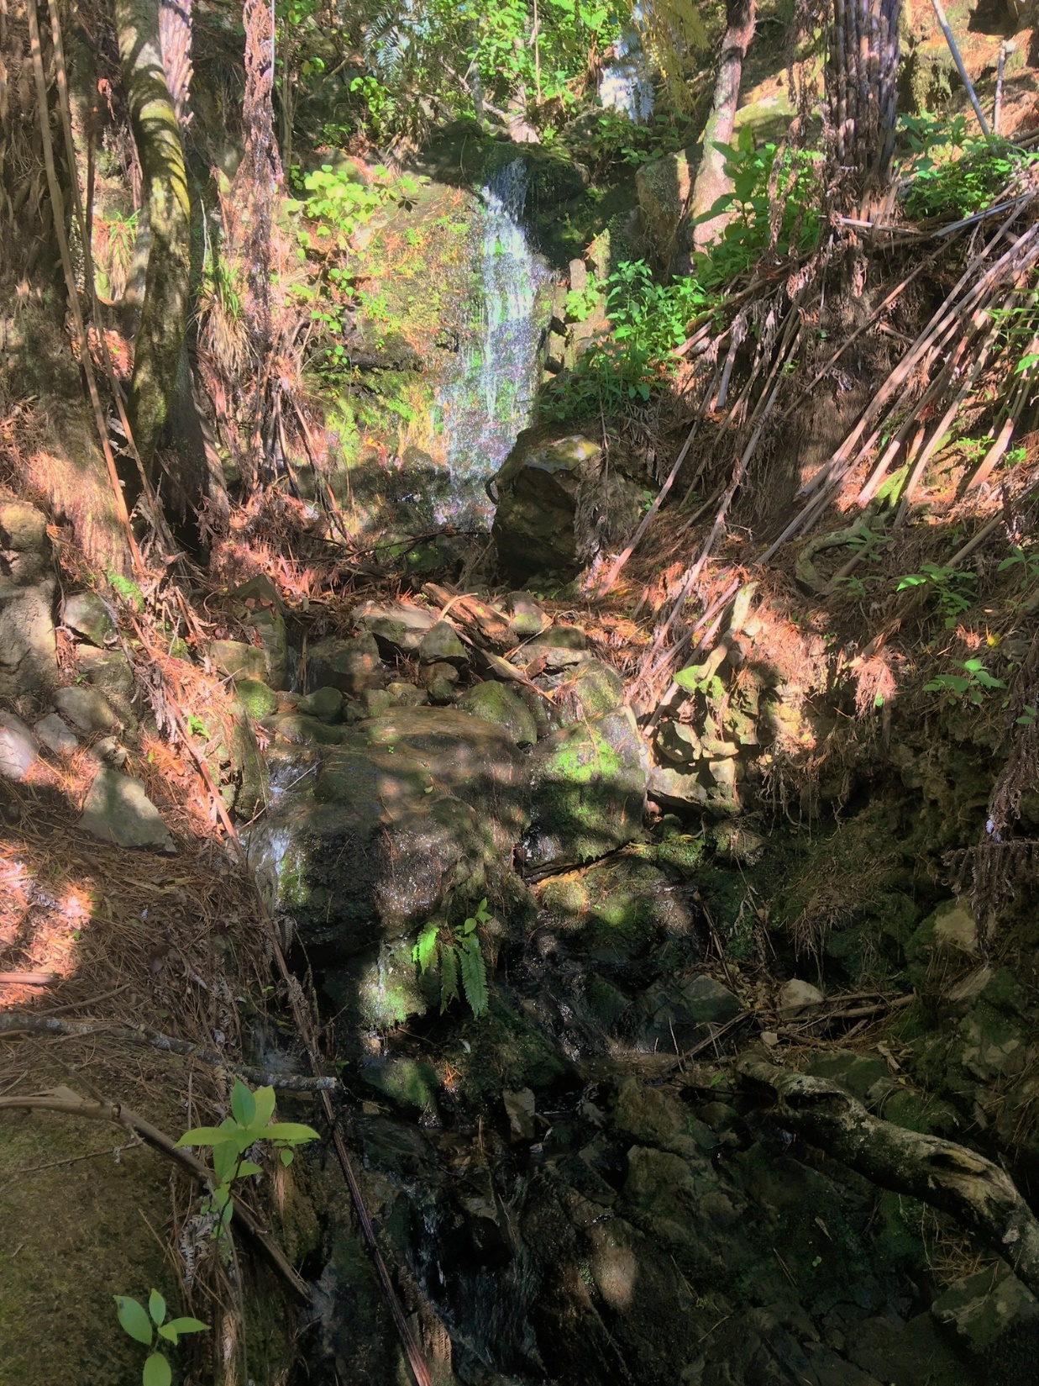
Any development on the spur will have a impact on flow rates of these streams and ephemeral watercourses, either by increased run off from roofs, driveways etc, or from removed vegetation.
These increased peak flow rates will overwhelm the infrastructure causing damage to the railway facility even with “storm water neutrality” incorporated into any design.

